Slide 1
Application of dimensionality reduction techniques in Phonetics
Yaqian Huang

Slide 2
Dimensionality
What is dimensionality?
Think about: the kind of data you are dealing with in your research
Production: acoustics, EGG, EMA, ultrasound, airflow, …
Perception: eye tracking
Notes:
Visualization of dimensions

Slide 3
Dimensionality
What is dimensionality?
When we fit a model with p predictors, we have to search for the parameters in a p-dimensional space
Each dimension is a “degree of freedom”
When the number of predictors becomes very large (high-dimensional data), overfitting becomes more likely
When p ≥ n, there are more parameters than data points and we are in the high-dimensional regime
Notes:
Visualization of dimensions

Slide 4
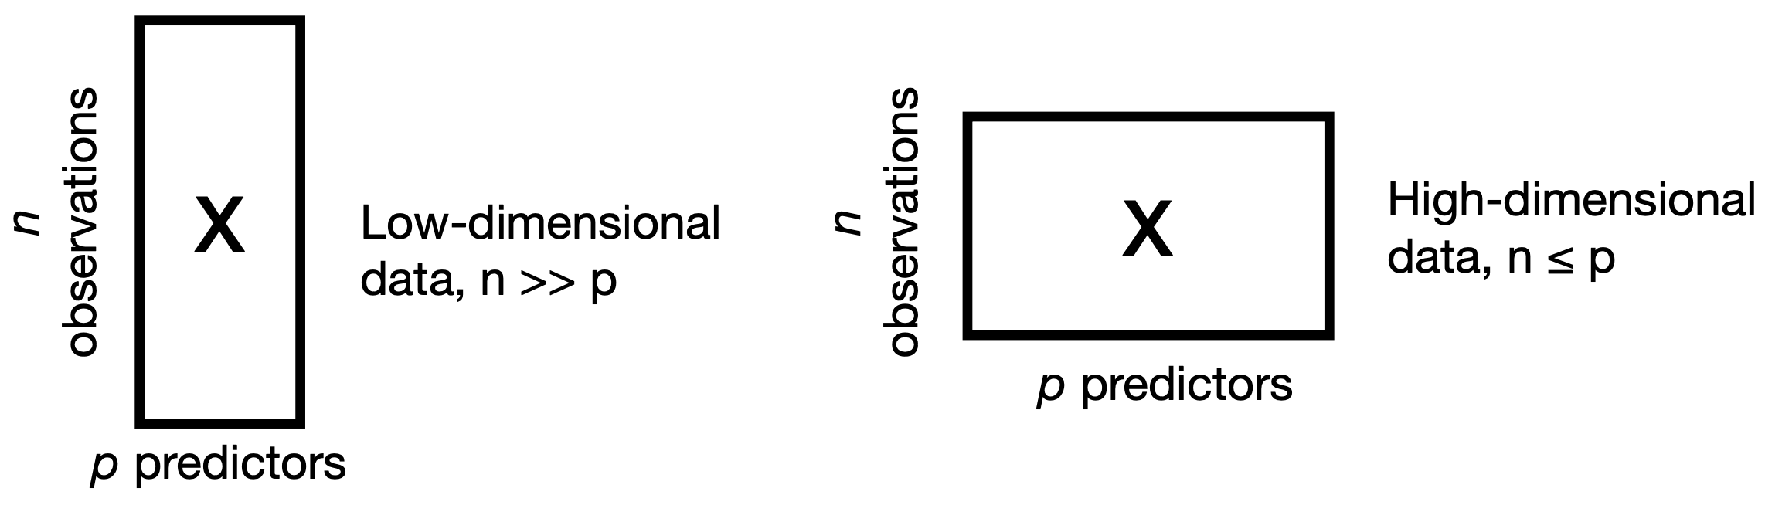
Dimensionality
What do we mean by high-dimensional?
Number of features > number of observations
Notes:
Visualization of low vs high dimensions

Slide 5
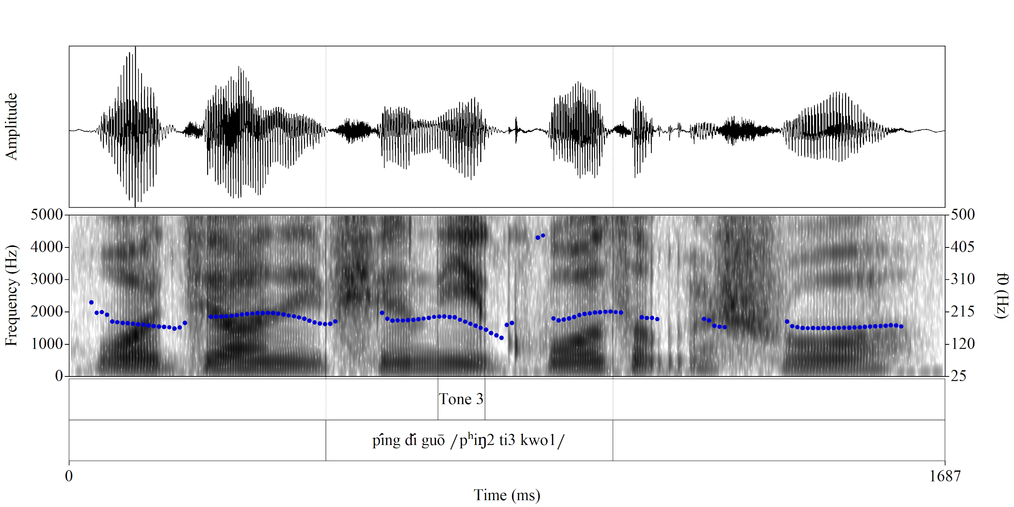
multidimensional spectrogram

Slide 6
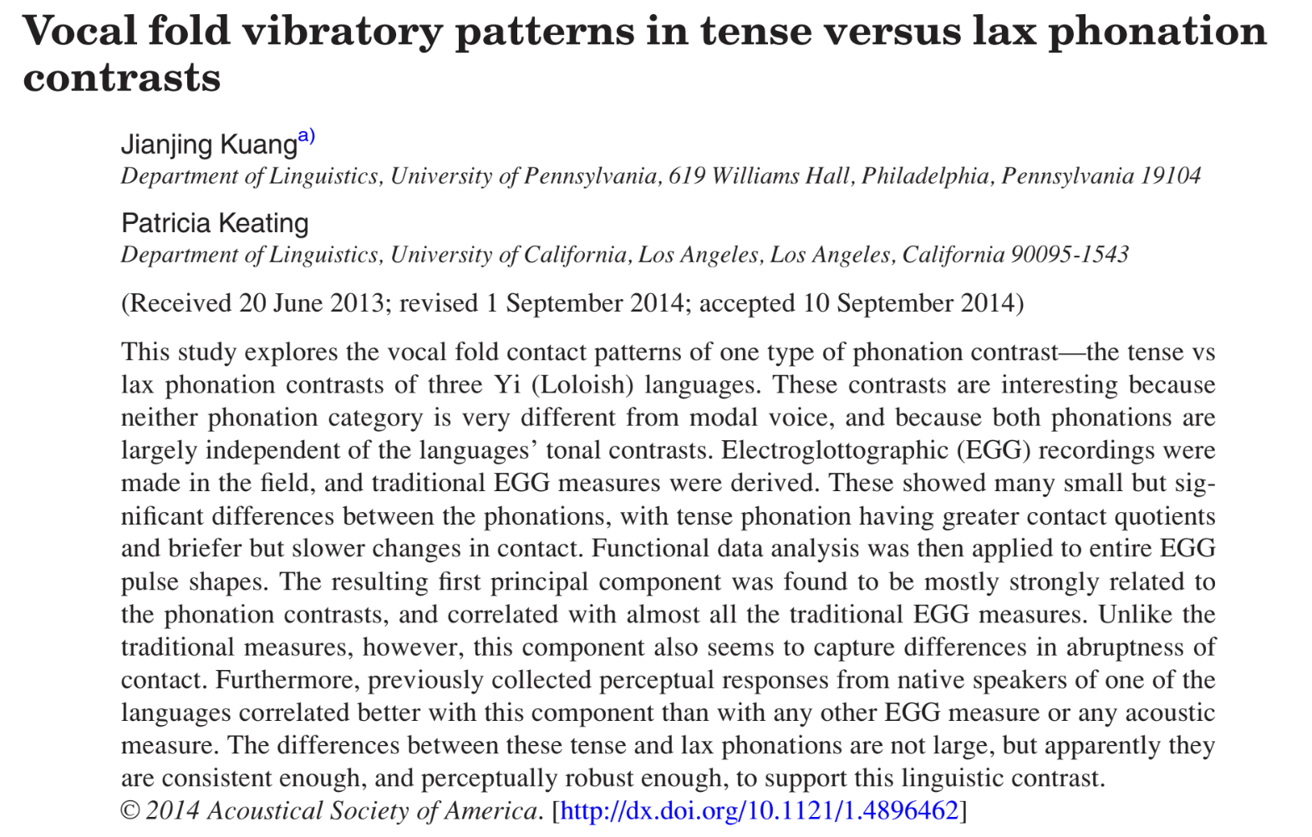
Examples: Predicting tense vs. lax phonation
functional principal component analysis (FPCA) used to correlate EGG pulses with phonation contrasts

Slide 7
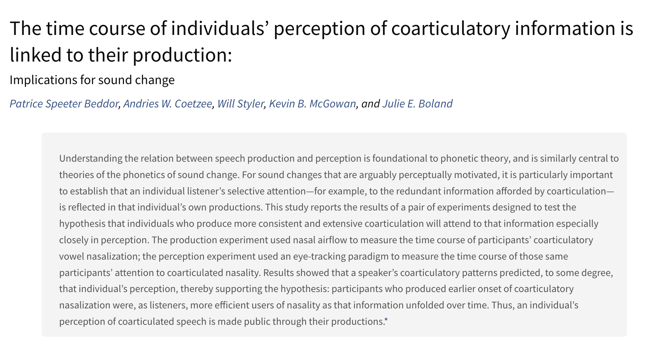
Examples: Modeling coarticulatory vowel nasalization
fPCA on average nasal airflow at each time point for each speaker
yielding components corresponding to orthogonal changes in the temporal pattern of airflow seen across the speakers

Slide 8
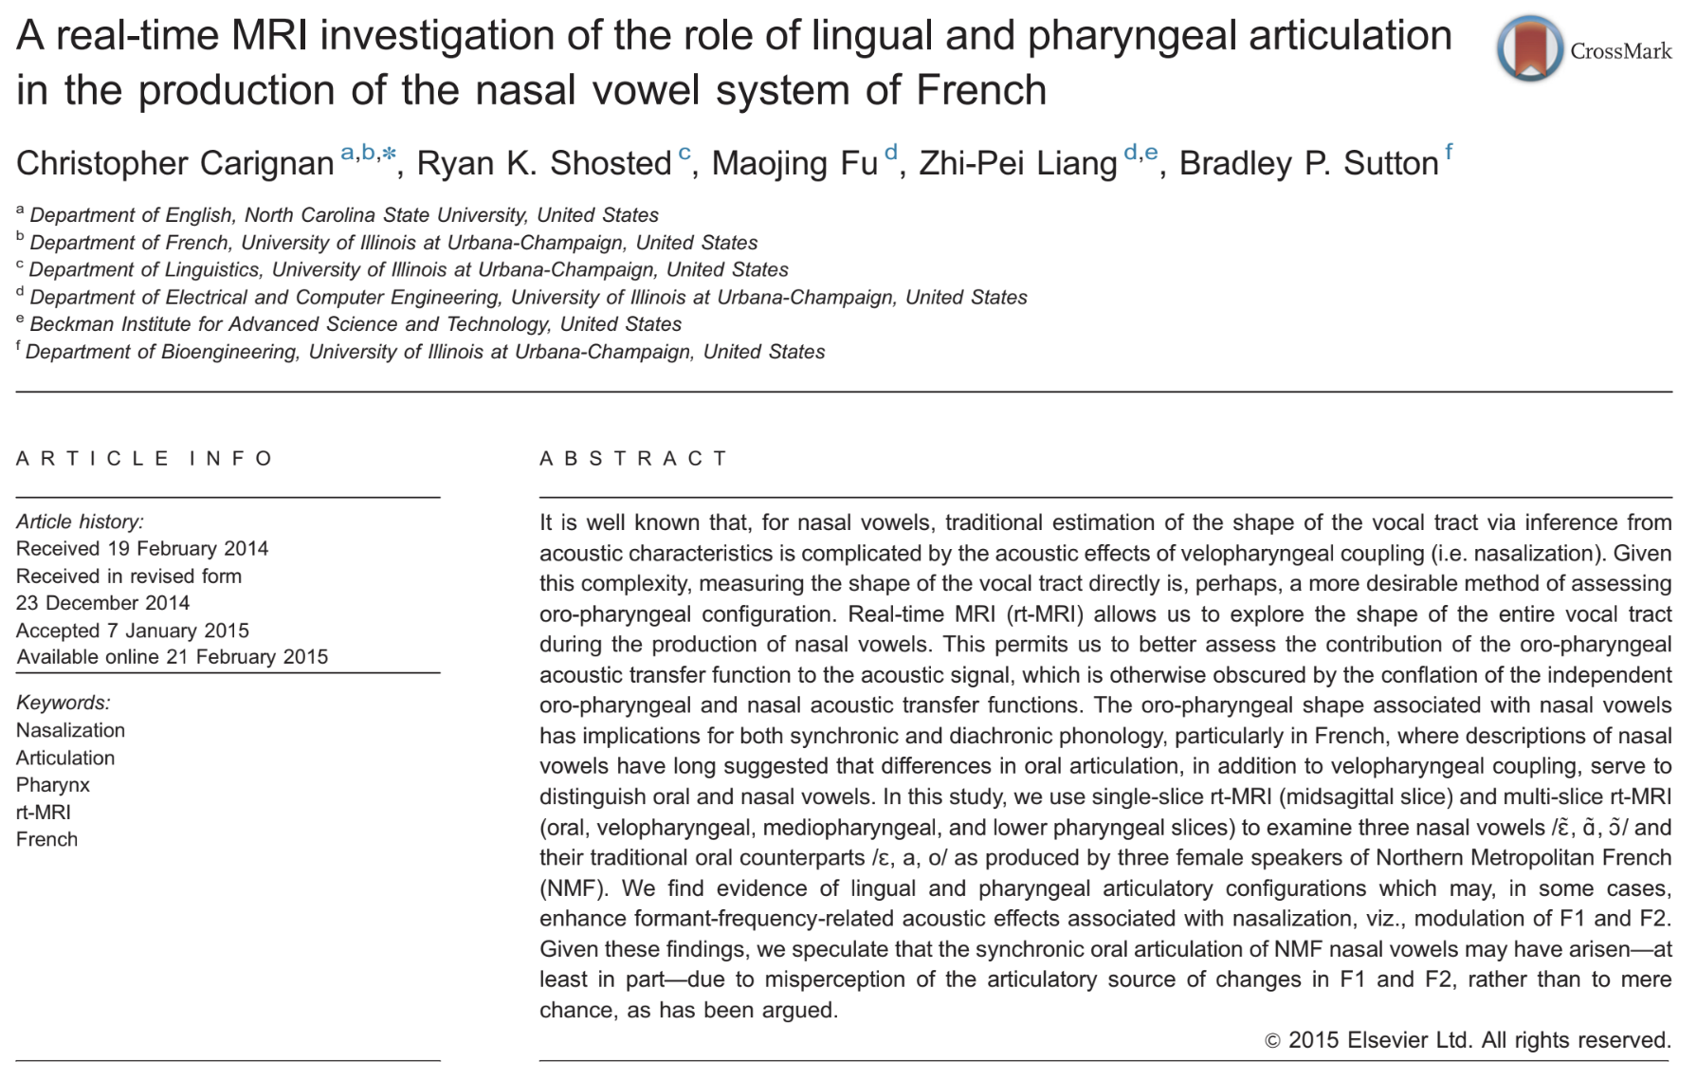
Examples: Modeling articulations of nasal vowels
PCA on MR images to model different positions: Midsagittal, Velopharyngeal, Coronal, Mediopharyngeal, Lower pharyngeal

Slide 9

Examples: Accent identification
Select discriminative features
Discard non-discriminative & noise features
LDA as feature selection

Slide 10
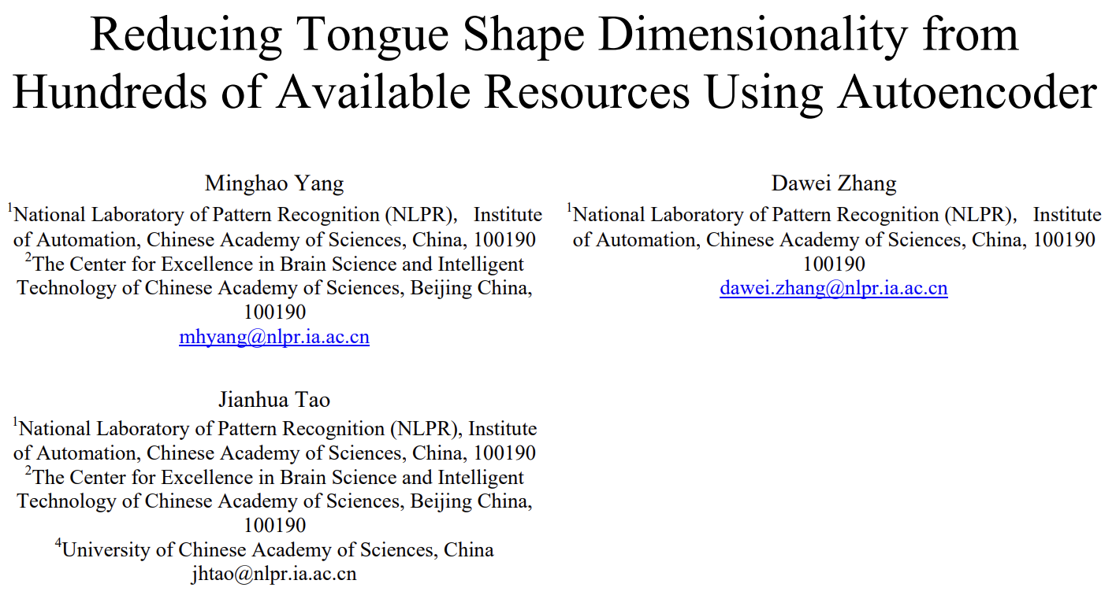
Examples: Modeling tongue shape
Autoencoder is used for reconstruction and assess contributions of different tongue parts to speech production
Notes:
Non-linear

Slide 11
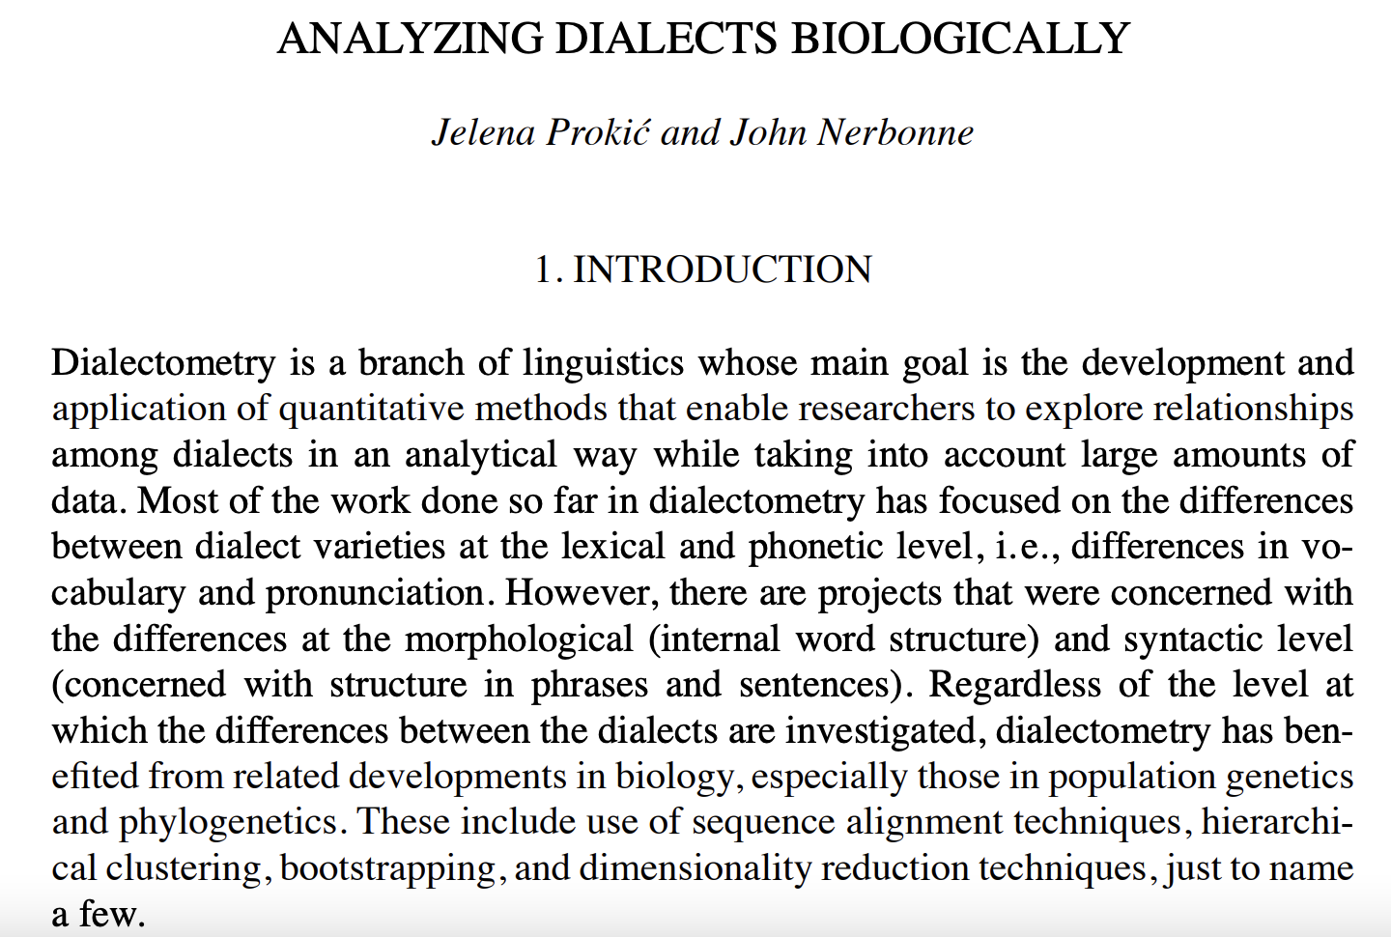
Examples: Dialectometry
Multidimensional scaling analysis (MDS) on clustering dialect groups and varieties

Slide 12
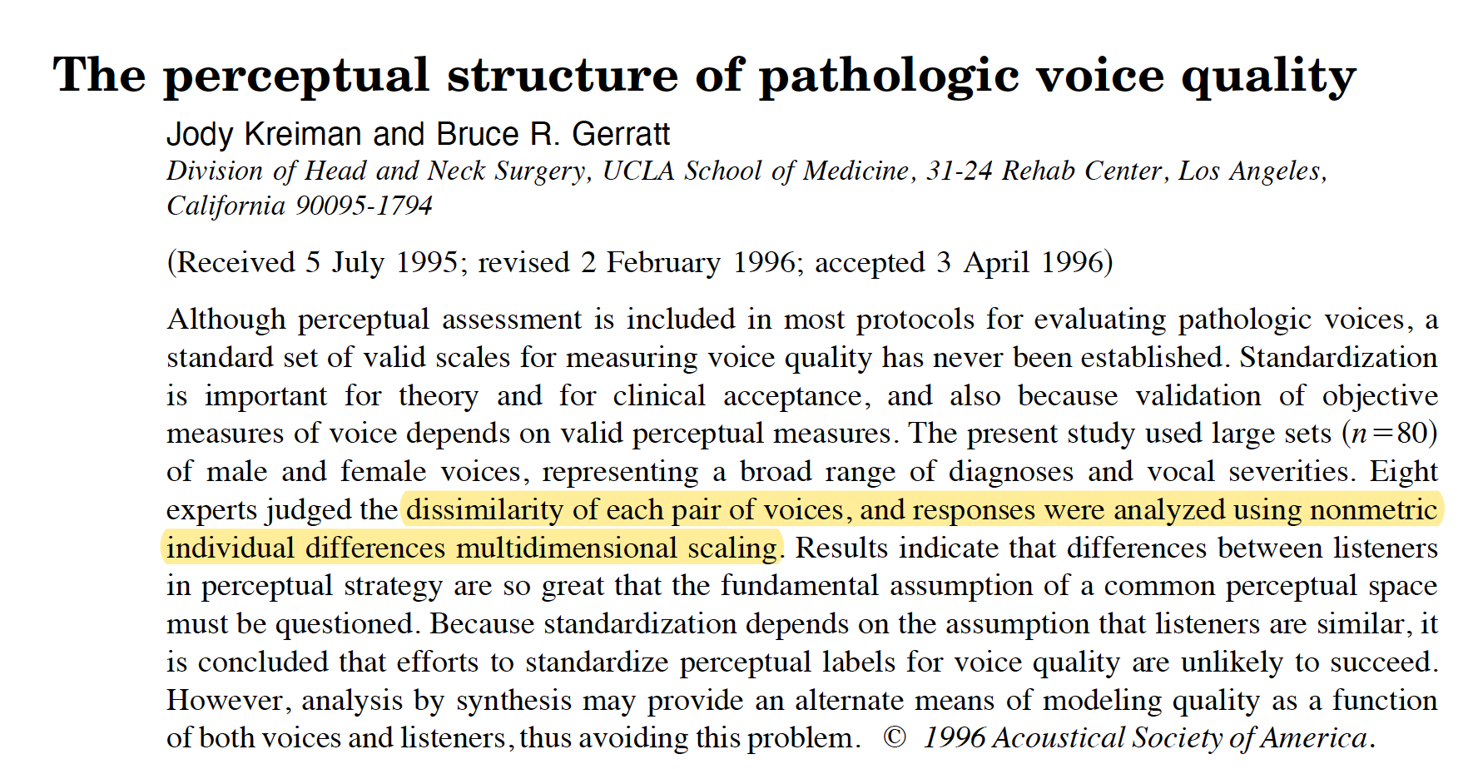
Examples: Voice perception
MDS on perceptual ratings of voice

Slide 13

Examples: Distinguishing units in speech/music
Locally linear embedding (LLE) to reduce the dimensionality of the audio signal while preserving the informative signatures (e.g., distinguish different phonemes in speech or identify particular instruments in music)
log-power spectra of phonemes as high dimensional inputs for unsupervised learning by PCA and LLE
Notes:
The phonetic transcriptions of the TIMIT corpus were used to locate particular phonemes.

Slide 14
Dimensionality
What do we mean by high-dimensional?
Think about: the kind of data you are dealing with in your research
Why do we need to reduce it?
Notes:
Visualization of dimensions

Slide 15
Dimensionality
Phonetic data is essentially multidimensional.
Any time-series data: LPC, pitch dynamics, duration, airflow, etc.
Family of spectral measures: what VoiceSauce outputs, for example
Images: ultrasound, MRI
Context: segmental & prosodic positions, word structure
Why
Less computational power & time
Avoid overfitting, multicollinearity
Data visualization
Latent variables
Reduce noise & Improve model accuracy
Notes:
LPC analyzes the speech signal by estimating the formants, removing their effects from the speech signal, and estimating the intensity and frequency of the remaining buzz. The process of removing the formants is called inverse filtering, and the remaining signal after the subtraction of the filtered modeled signal is called the residue.

Slide 16
Dimensionality
What do we mean by high-dimensional?
Think about: the kind of data you are dealing with in your research
Why do we need to reduce it?
How do we reduce it?
Notes:
Visualization of dimensions

Slide 17
Dimensionality
Phonetic data is essentially multidimensional.
Any time-series data: LPC, pitch dynamics, duration, airflow, etc.
Family of spectral measures: what VoiceSauce outputs, for example
Images: ultrasound, MRI
Context: segmental & prosodic positions, word structure
Why
Less computational power & time
Avoid overfitting, multicollinearity
Data visualization
Latent variables
Reduce noise & Improve model accuracy
How (more next workshop)
Exploratory: data visualization first, patterns second
Confirmatory: principled way of devising independent variables
Notes:
LPC analyzes the speech signal by estimating the formants, removing their effects from the speech signal, and estimating the intensity and frequency of the remaining buzz. The process of removing the formants is called inverse filtering, and the remaining signal after the subtraction of the filtered modeled signal is called the residue.

Slide 18
Dimensionality reduction methods
Feature reduction
Model selection
Data transformation
Linear
Regularization (constraining parameter values)
cross-validation
step-wise selection
forward (M0 = null)
backward (M1 = full)
Non-linear
PCA
LDA
Kernel PCA
t-SNE
UMAP
MDS
Feature selection
random forest
Notes:
High variance
Overfitting problems

Slide 19
Dimensionality reduction
Model selection: reduce predictors -> check correlation!
Regularization: shrinkage, constraining parameter values
Projecting onto low-dimensional space
Linear:
PCA
LDA
Non-linear (manifold):
Kernel-PCA
MDS
t-SNE
UMAP
Related ML topics: classification, clustering, random forest

Slide 20
Correlation plot
Notes:
Cogs 260??
Not my data
But can experiment on voice categories

Slide 21
PCA
Linear
Scaled data input
Unsupervised (compare to LDA)
Compressed representation of the data
Principal components: transforms a set of correlated variables into a smaller number of uncorrelated variables → orthogonality
Retaining as much of the variation in the original dataset as possible
Notes:
Cogs 260??
Not my data
But can experiment on voice categories

Slide 22

PCA
The first PC (PC1) has the maximum variance of any linear combination of the predictors
PC2 has the max. variance of any linear combination of predictors that is uncorrelated with PC1
PC3 has the max. variance of any linear combination of predictors that is uncorrelated with PC1 and PC2
…
Notes:
Cogs 260??
Not my data
But can experiment on voice categories

Slide 23
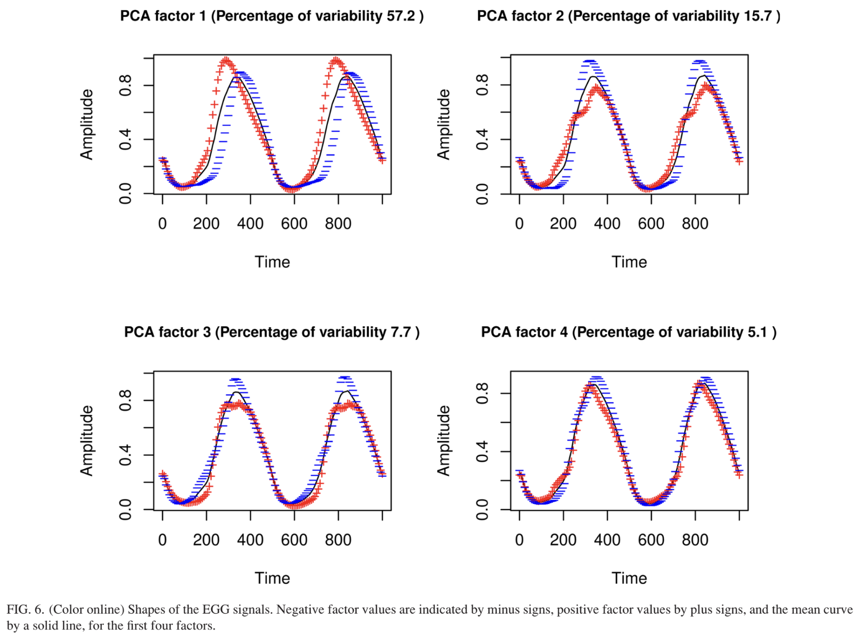
PCA
Kuang & Keating (2014)
Used to identify the main factors of variability in the EGG pulses
Notes:
Cogs 260??
Not my data
But can experiment on voice categories

Slide 24
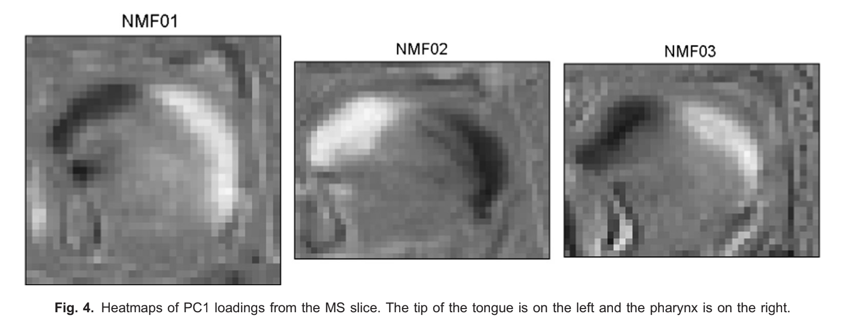
PCA
Carignan et al. (2015)
Brighter pixels are indicative of tissue in MR images and darker pixels are indicative of bone or air.
Similar to previous use of PCA for face recognition and feature extraction of lingual configurations in ultrasound images
Each PCA model included one set of n pixel intensities (columns/variables) for each of m images (rows/observations) in the corpus for each MR slice.
Notes:
Principal component analysis (PCA) models applied to pixels in the ROIs for both single- and multi-slice images.
Positive loadings for pixels with respect to individual PCs are associated with movement of tissue into the pixel; negative loadings are associated with movement of tissue out of the pixel. We scaled the loadings using a grayscale heatmap, where black and white represent maximum negative and positive values, respectively, while minimum values (close to zero) verge on 50% gray (loading value1⁄40).

Slide 25
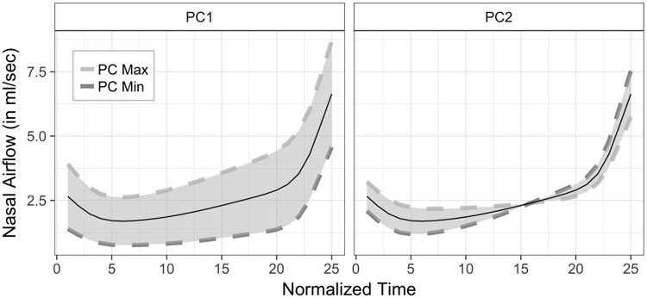
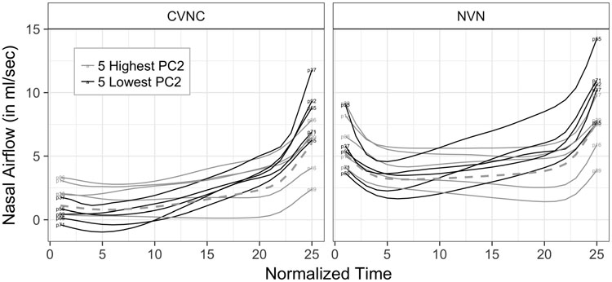
PCA
Beddor et al. (2018)
PCs of nasal airflows in coarticulatory nasal vowels
Notes:
Principal component analysis (PCA) models applied to pixels in the ROIs for both single- and multi-slice images.
Positive loadings for pixels with respect to individual PCs are associated with movement of tissue into the pixel; negative loadings are associated with movement of tissue out of the pixel. We scaled the loadings using a grayscale heatmap, where black and white represent maximum negative and positive values, respectively, while minimum values (close to zero) verge on 50% gray (loading value1⁄40).

Slide 26
LDA
Typically used for multi-class classification
Also a dimensionality reduction technique
A linear combination of input features that optimizes class separability
Unscaled data OK; need to be normally distributed
Supervised algorithm: takes class labels into account
Notes:
Cogs 260??
Not my data
But can experiment on voice categories

Slide 27
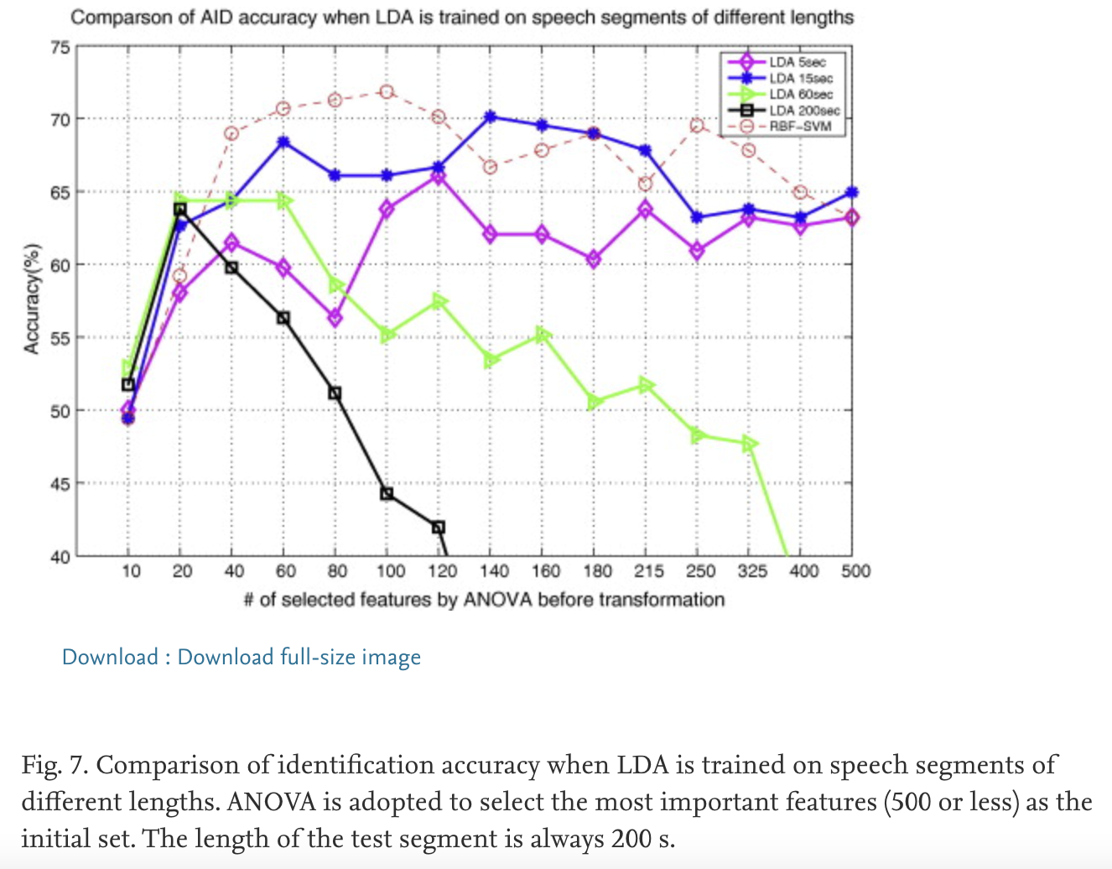
LDA
Wu et al. (2010)
Accent identification using LDA trained on speech segments of different lengths

Slide 28
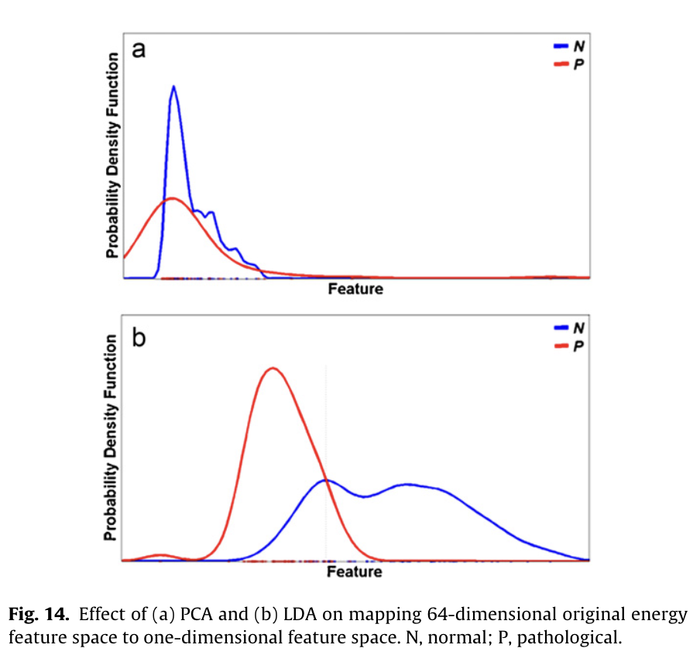
LDA
Arjmandi & Pooyan (2011)
Pathological voice quality assessment using PCA & LDA
Data: time-frequency localized coefficients of speech signals
Notes:
wavelet-packet decomposition of the speech signal

Slide 29
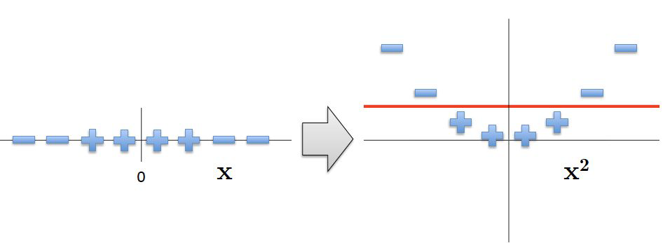
Kernel-PCA
When the decision surface is not linear, we can project the original values in lower dimensional space to some higher dimension.
Idea: use kernel function to implicitly map the points in original lower dimensional space to some higher dimensional space in which the points are linearly separable.

Slide 30
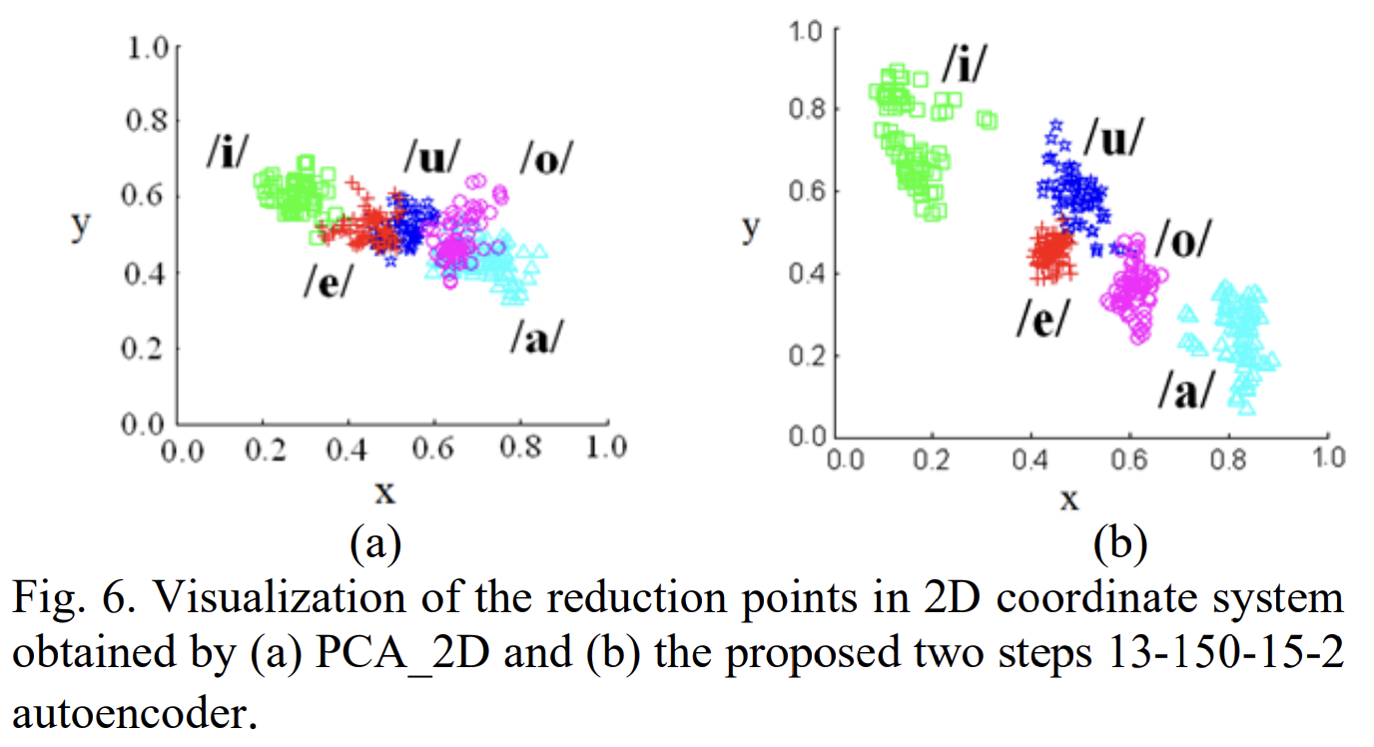
Autoencoder
Non-linear
Encoder-decoder system
Multiple layers
Yang et al. (2018)

Slide 31
Multidimensional scaling (MDS)
Non-linear
Preserve the distances between instances globally
Often operate on distance matrix
Similarity vs. dissimilarity among data
Suitable for data that form a continuum, rather than clearly separated groups

Slide 32
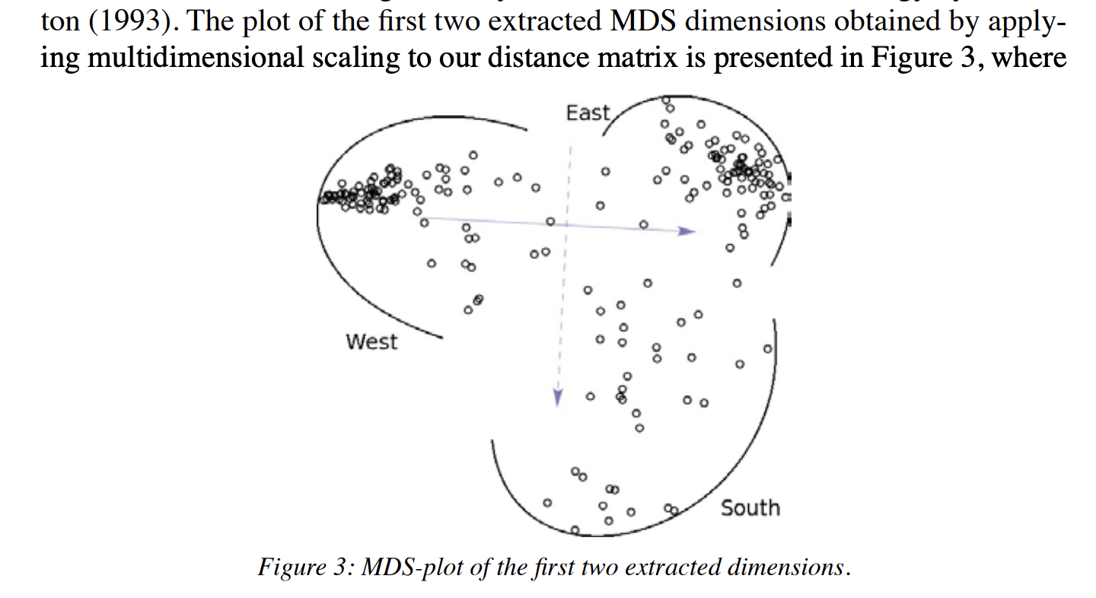
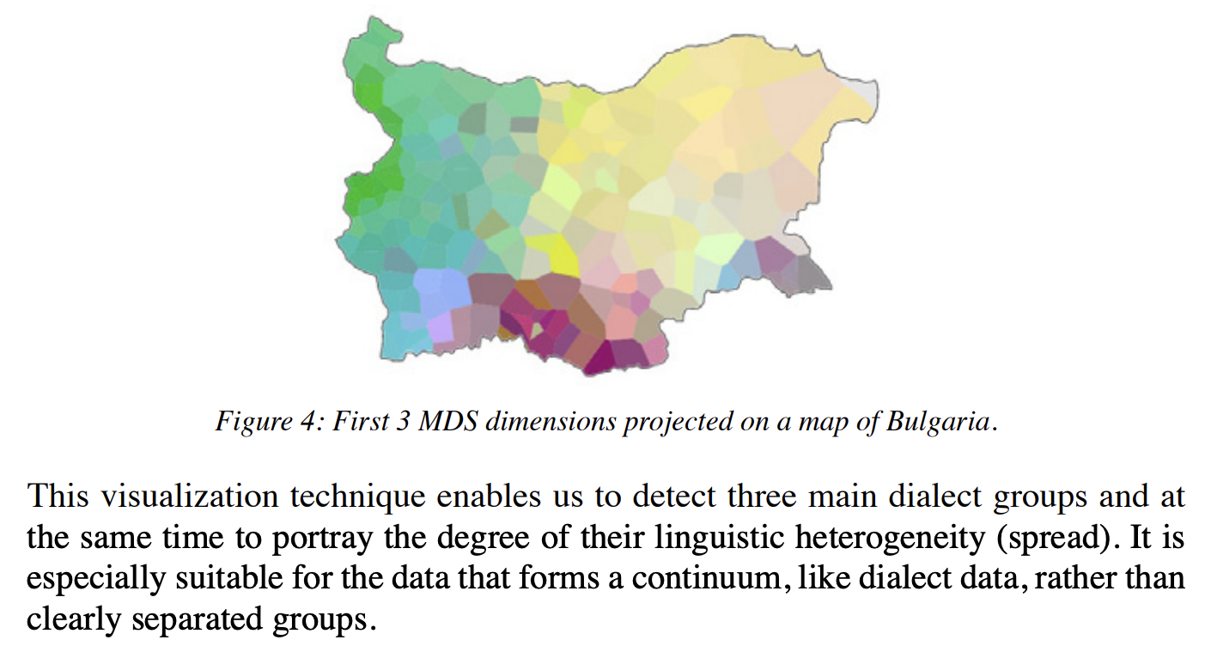
MDS: dialectometry
Detect dialect groups; portray the degree of linguistic heterogeneity (spread)
Distance matrix based on pronunciation alignment across words
Prokić, J., & Nerbonne, J. (2013)
Notes:
examined specific positions (sounds) in specific words in an effort to find characteristic elements (the vowel in the second syllable of млякото /mlʲakoto/ ‘milk’) for a given cluster, while at the same keeps track of the context in which the element occurs

Slide 33
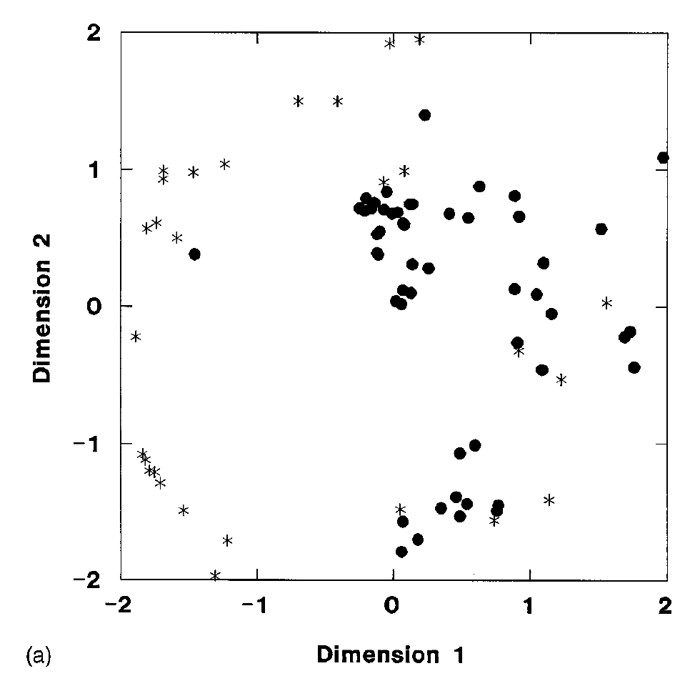
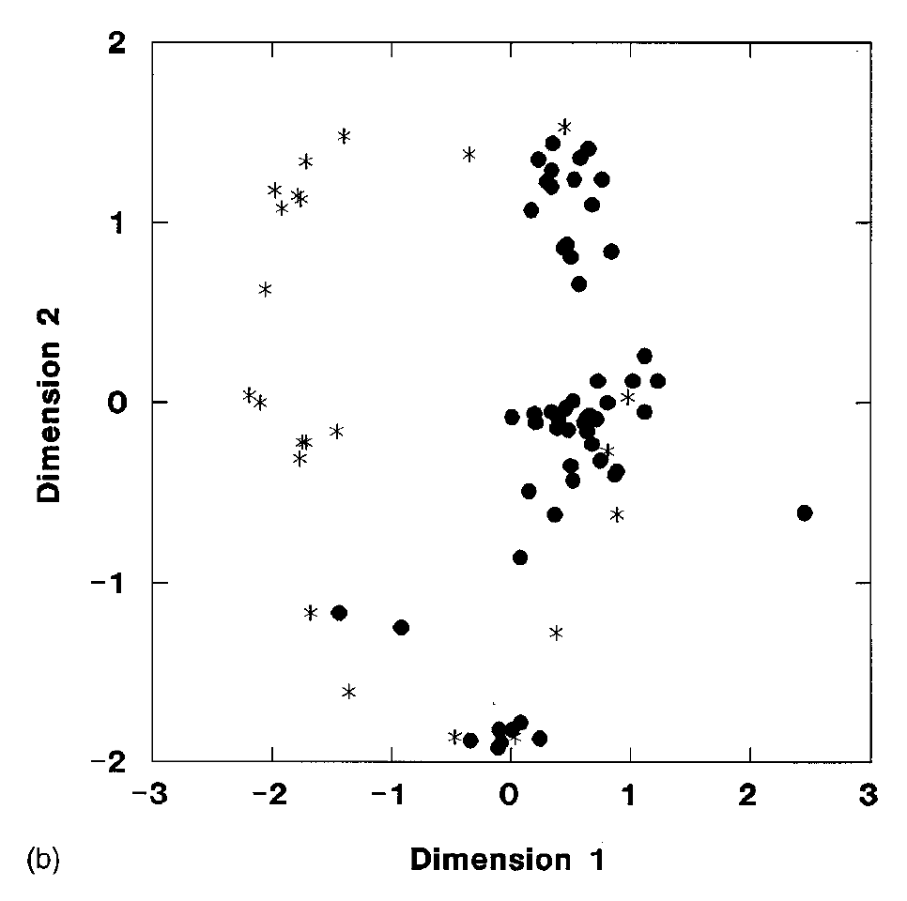
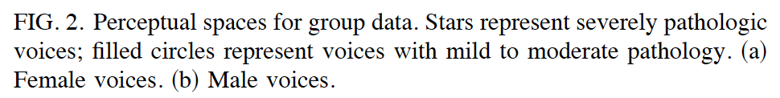
MDS: voice perception
Kreiman & Gerratt (1996)
Dissimilarity rating: 1-7
Notes:
examined specific positions (sounds) in specific words in an effort to find characteristic elements (the vowel in the second syllable of млякото /mlʲakoto/ ‘milk’) for a given cluster, while at the same keeps track of the context in which the element occurs

Slide 34
MDS: predicting voice categories
Within random forest
Acoustic features
Acoustic + articulatory features
Notes:
Random forest??
Sort n rate study

Slide 35
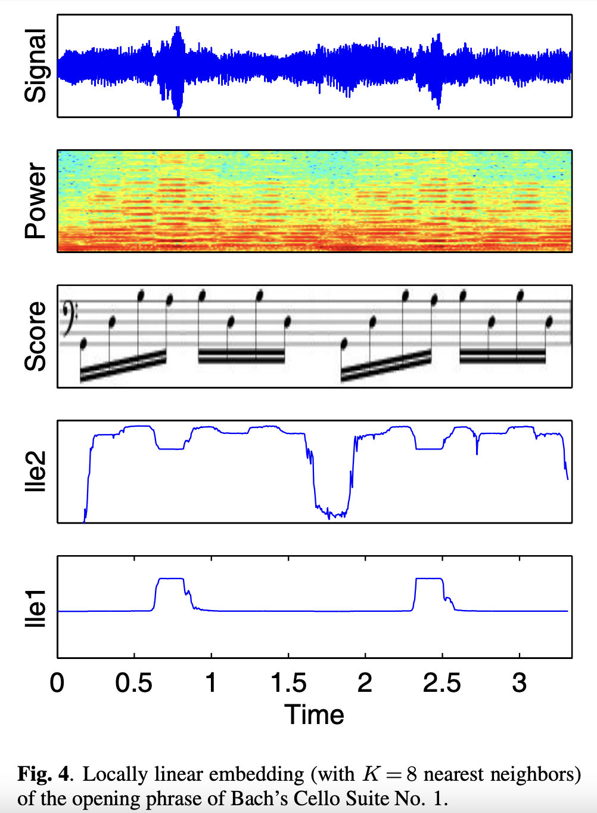
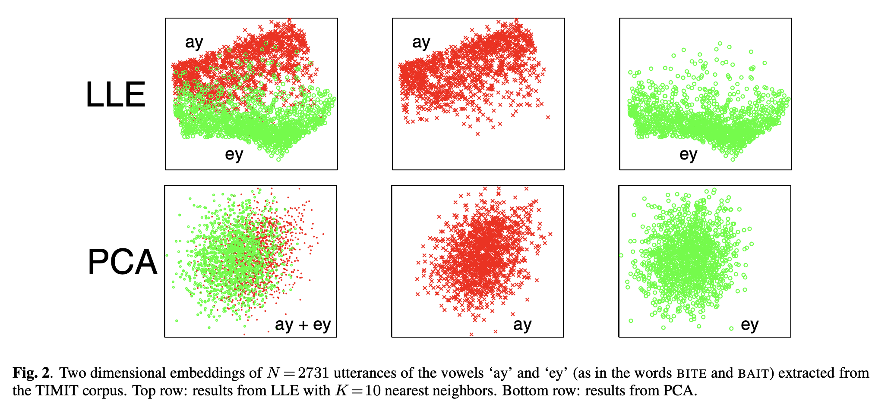
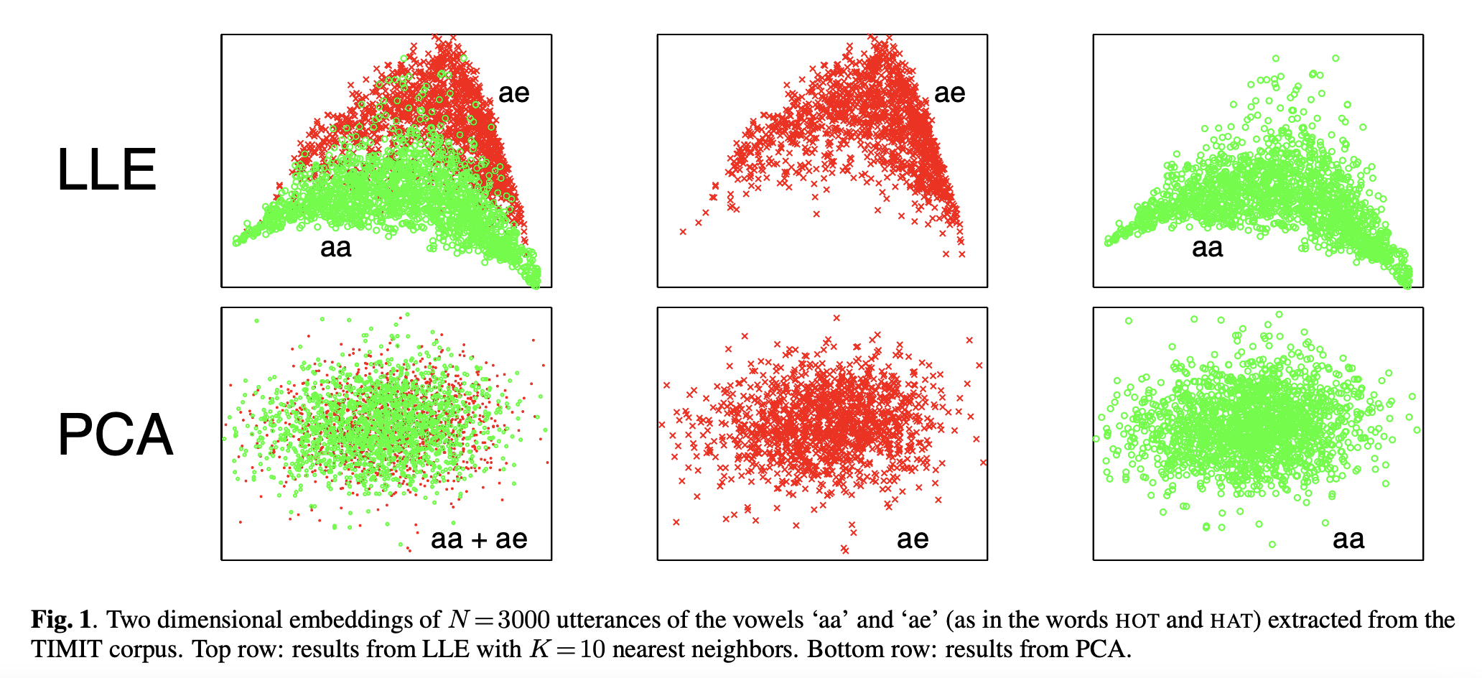
Locally linear embedding
Jain & Saul (2004) on visualizing speech & music units
Notes:
nearby points in the high-dimensional space remain nearby and similarly co-located with respect to one another in the lowdimensional space

Slide 36
t-SNE
t-distributed Stochastic Neighbor Embedding
Data visualization – the “go to”
Scaled data
Construction of probability distributions from pairwise Euclidean distances
larger distances ~ smaller probabilities and vice versa
Most commonly used learning method in single-cell analysis
Limitations: slow computation time, inability to meaningfully represent very large datasets, loss of large scale information
Good at both local & global structures (compare with MDS, UMAP)
Notes:
Similarly co-located with respect to their neighbors
The focus on local geometric properties distinguishes LLE from other algorithms for dimensionality reduction, such as multidimensional scaling [9] and
Isomap [5], which attempt to preserve global properties such as the pairwise distances between all inputs. The focus on local properties in LLE also has the benefit of yielding sparse matrices, whose
operations and optimizations scale better to large data sets

Slide 37
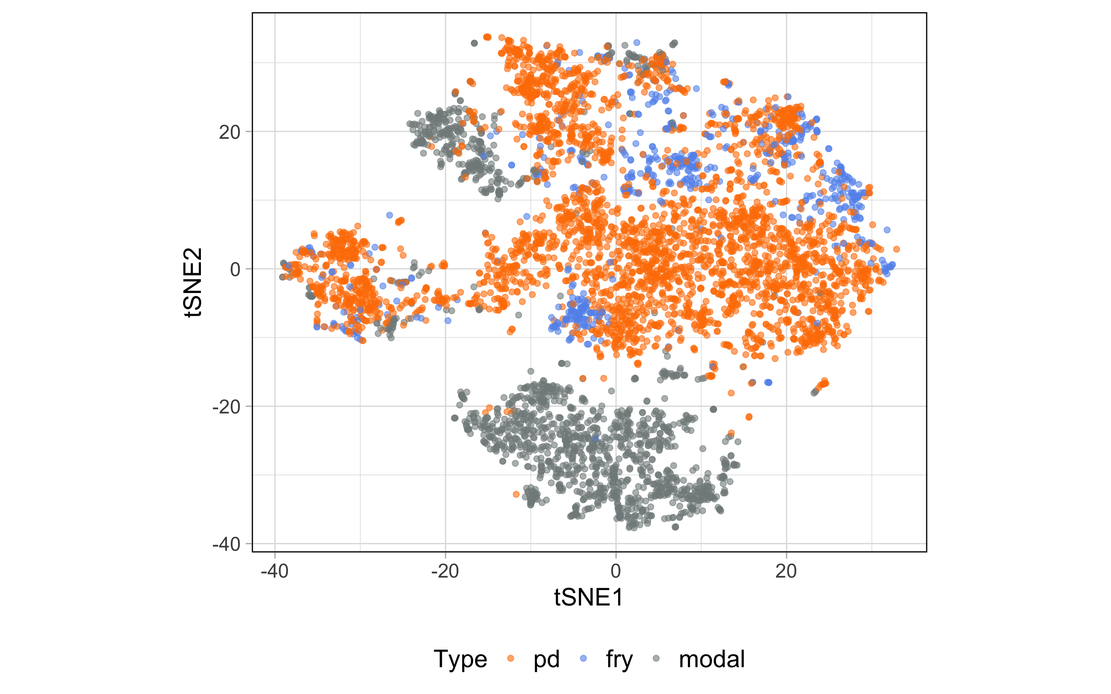
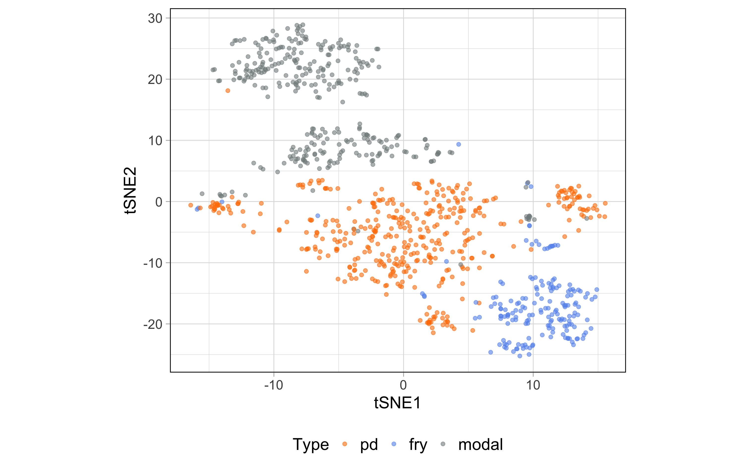
t-SNE
Acoustic features
Acoustic + articulatory features

Slide 38
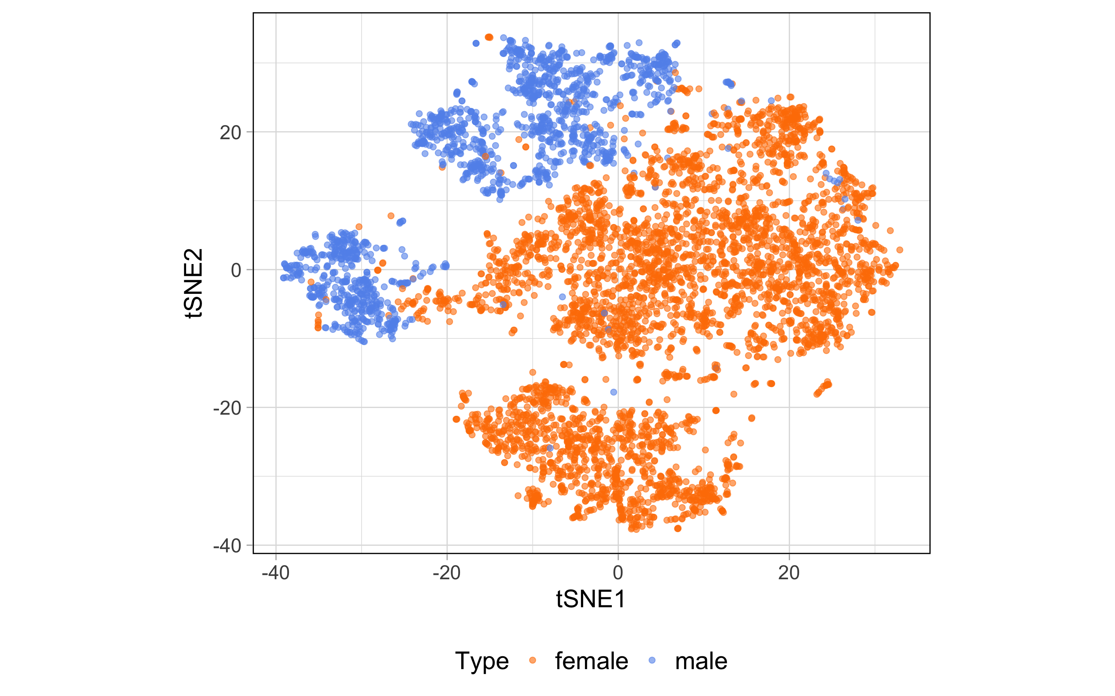
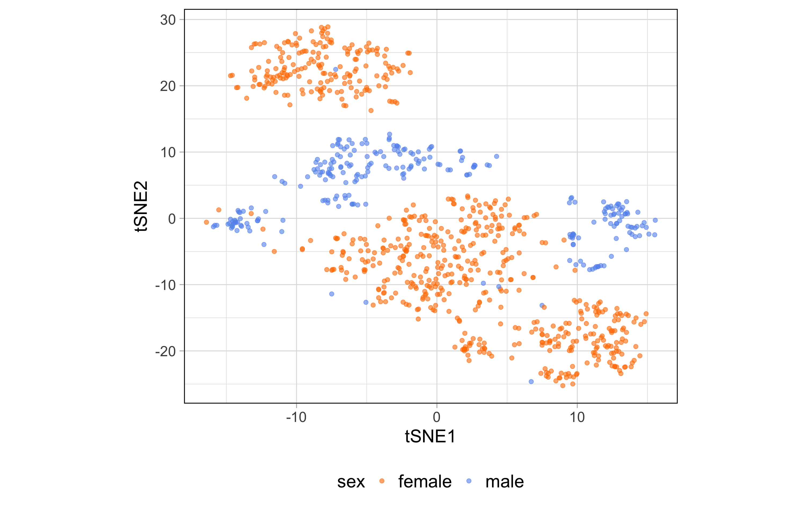
t-SNE
Acoustic features
Acoustic + articulatory features

Slide 39
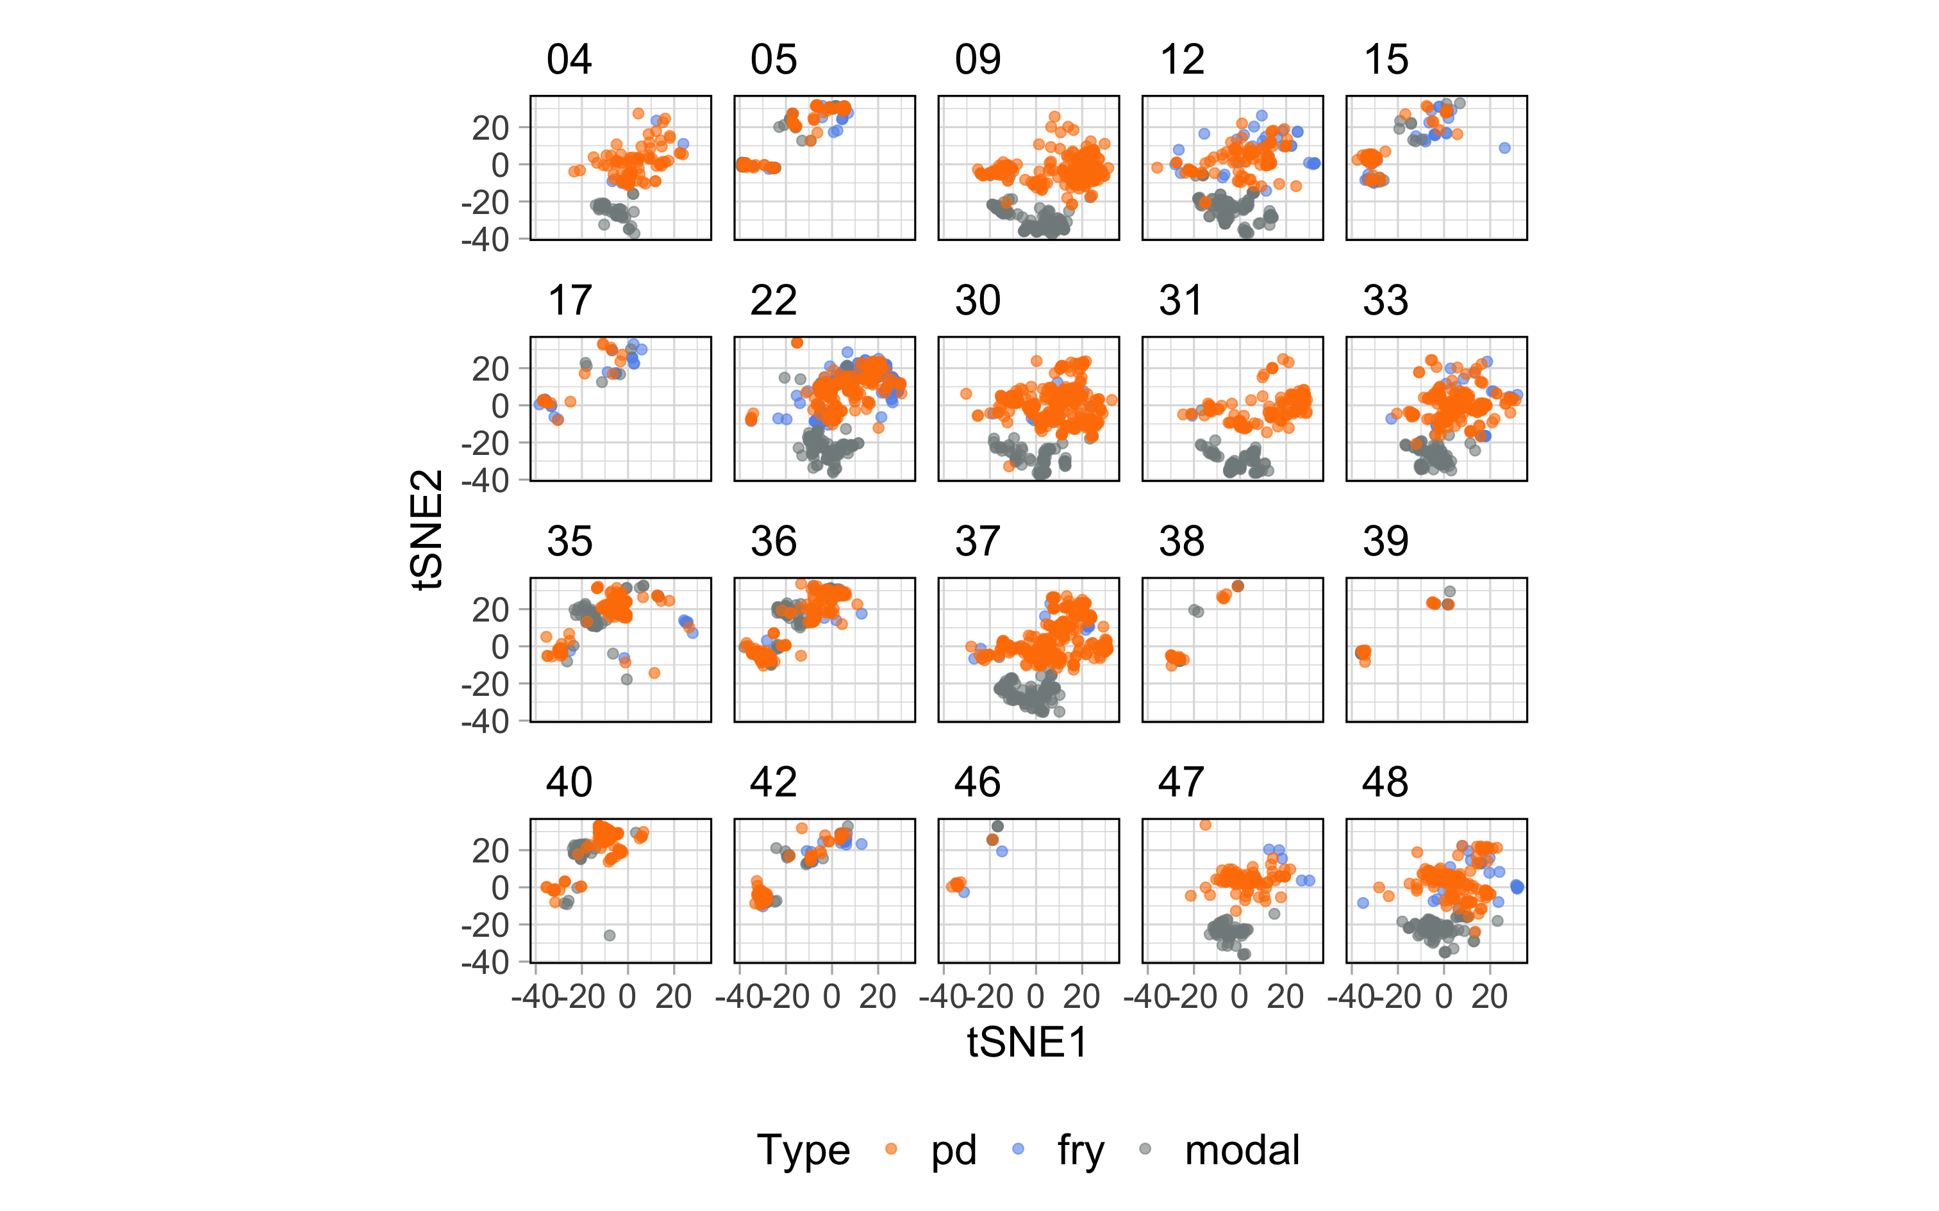
t-SNE
Notes:
Voice clusters

Slide 40
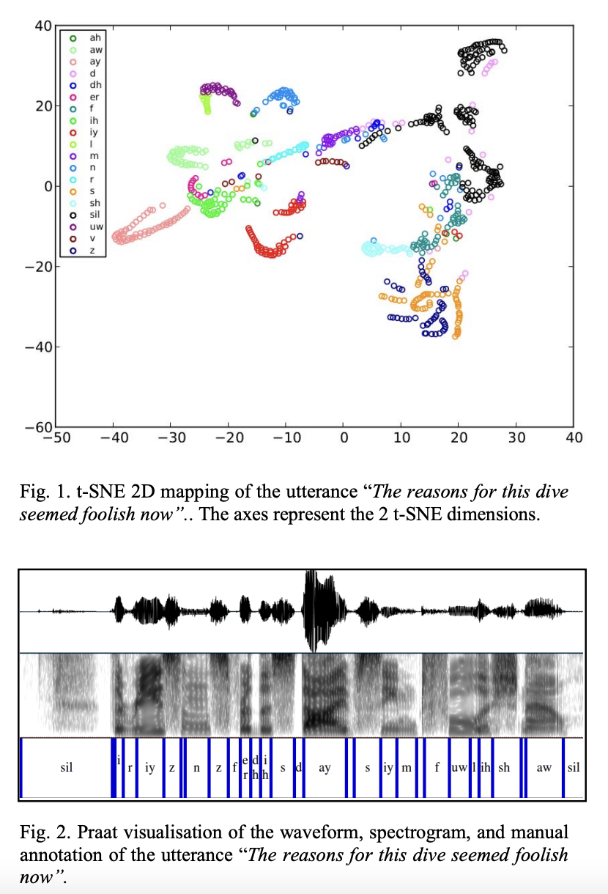
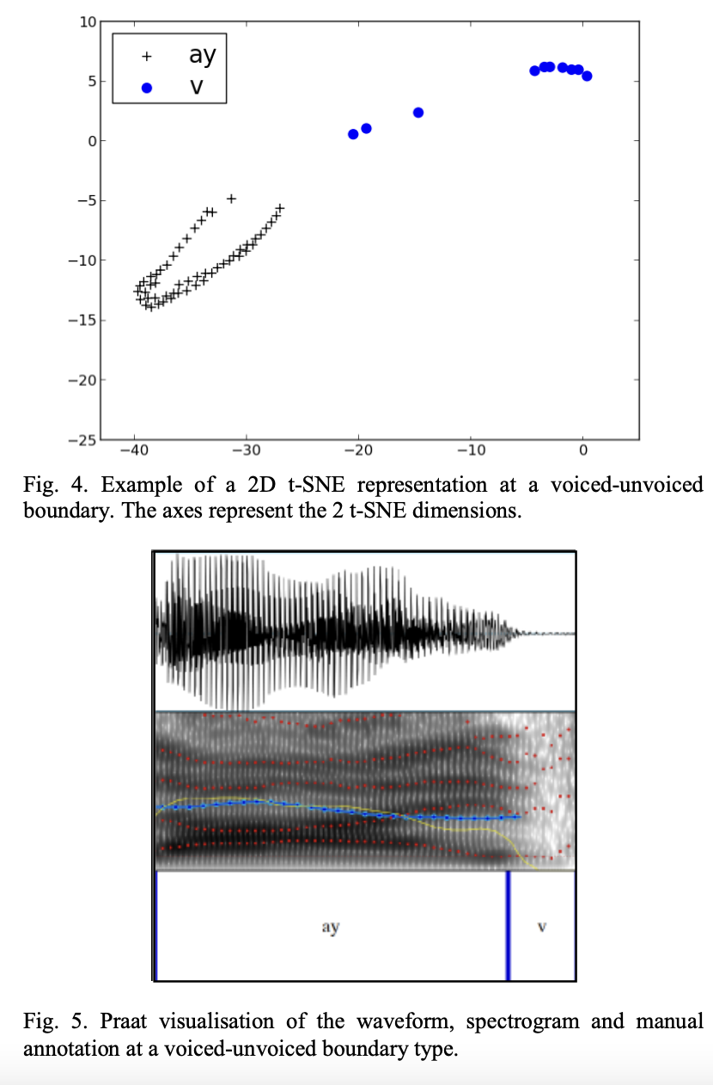
t-SNE
Stan et al. (2015)
perform phoneme-level segmentation of speech
Notes:
Voice clusters

Slide 41
UMAP
Uniform Manifold Approximation and Projection for Dimension Reduction
Preserve global structures of the original data (similar to MDS)
Notes:
Voice clusters

Slide 42
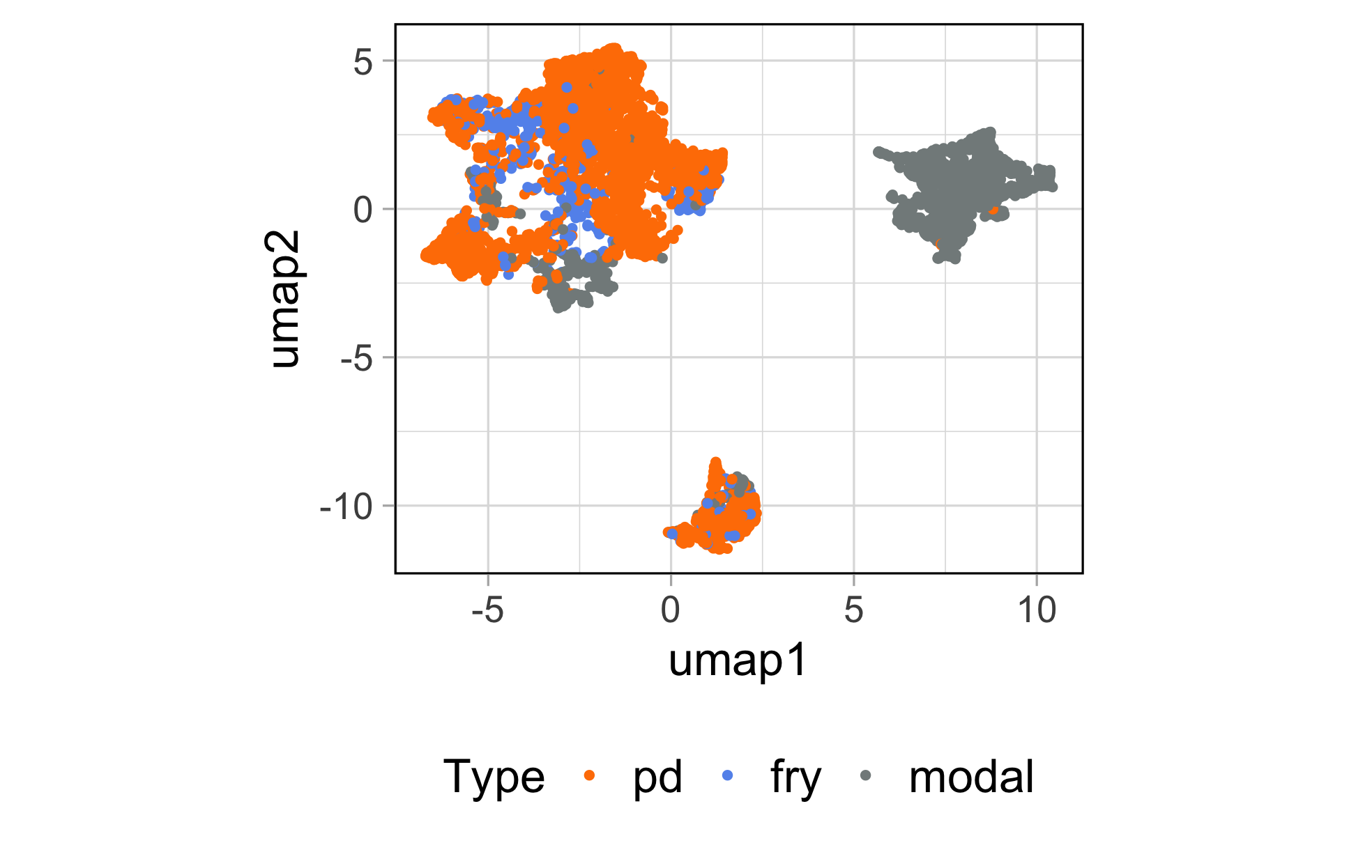
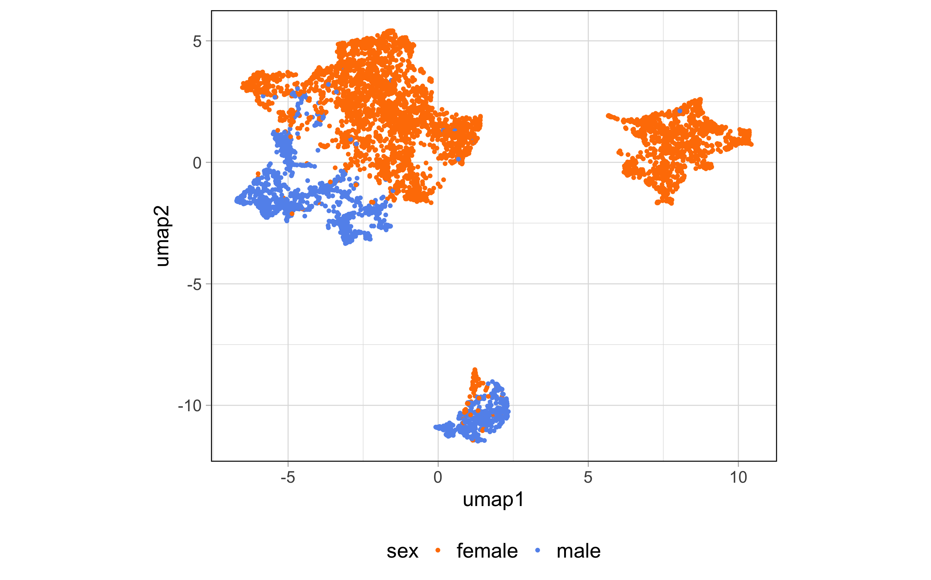
UMAP
Notes:
Voice clusters

Slide 43
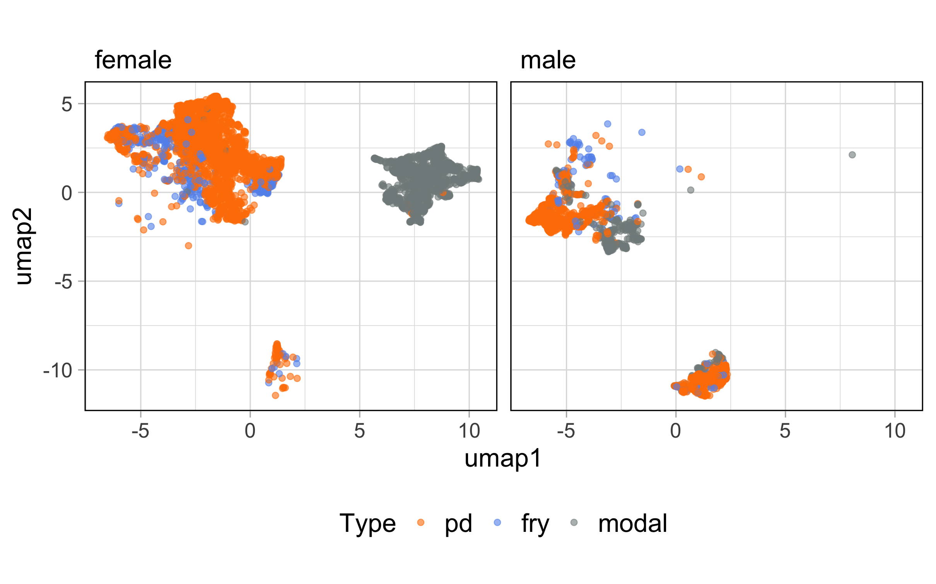
UMAP
Notes:
Voice clusters

Slide 44
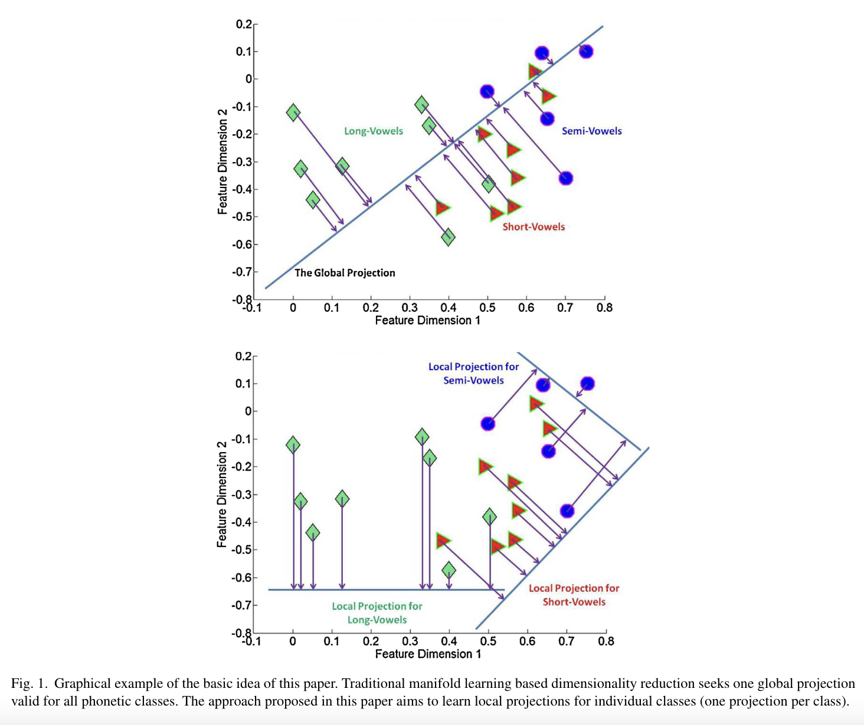
Other manifold variants
Huang et al. (2015)
Locally learning heterogeneous manifolds for phonetic classification
Address structure in the acoustic space
Notes:
Voice clusters

Slide 45
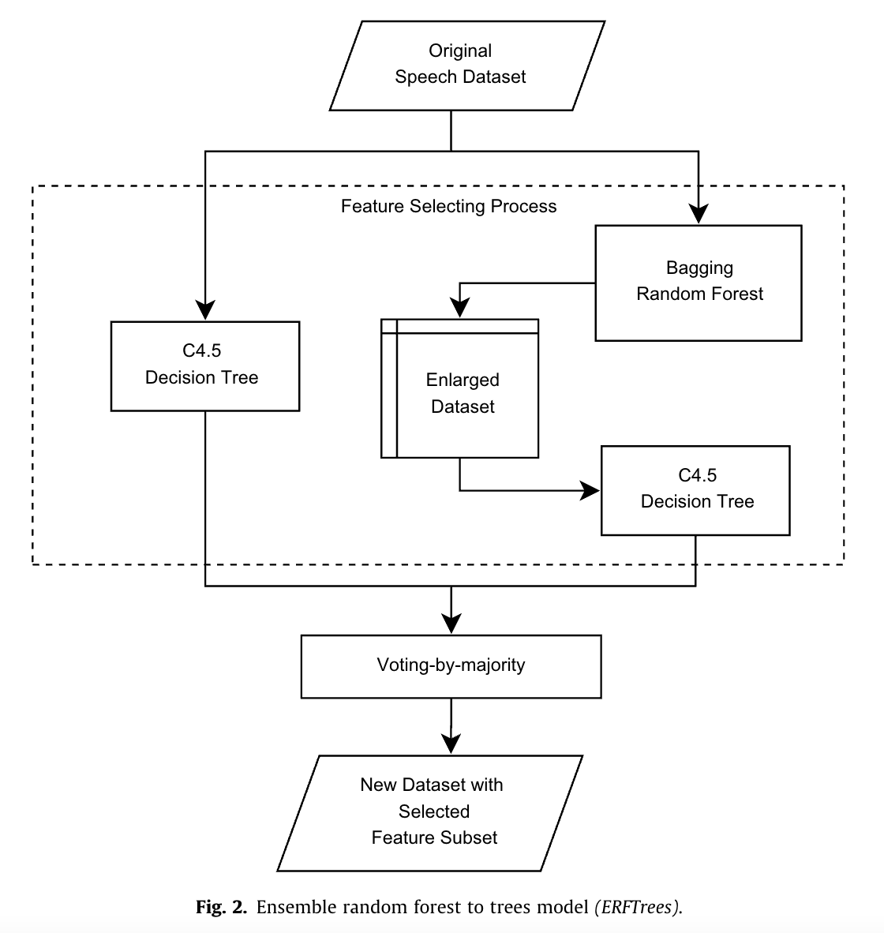
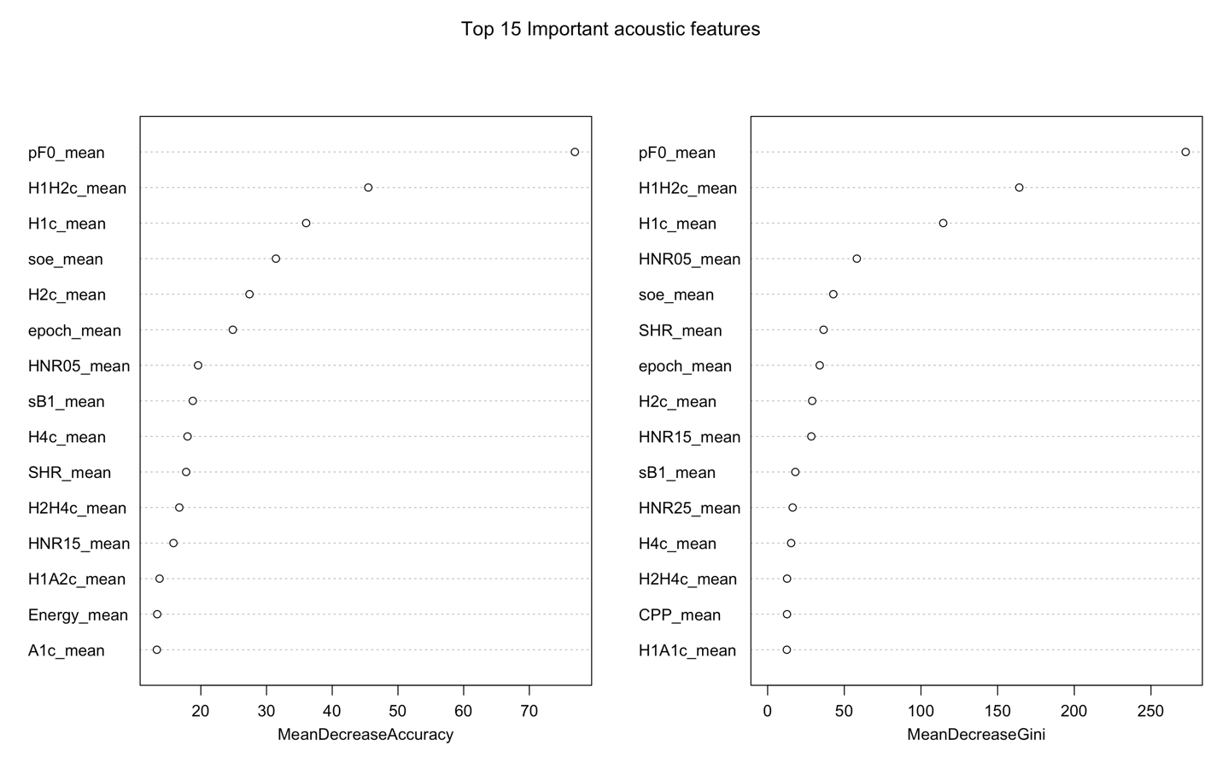
Random forest
Rong et al. (2009) Acoustic feature selection for automatic emotion recognition from speech
Huang (2022)
Notes:
Voice clusters

Slide 46
Regularization
Reduce unnecessary predictors
Prevent overfitting in a different way from variable selection, by “shrinking” the coefficient values
Idea: add a penalty term which controls model complexity by forcing the parameters
Use scaled data
Ridge regression uses ALL the predictors, it just shrinks the parameters closer to zero
LASSO shrinks some of the predictors all the way to zero
This makes the model more interpretable: It only uses a subset of the variables
Notes:
Voice clusters

Slide 47
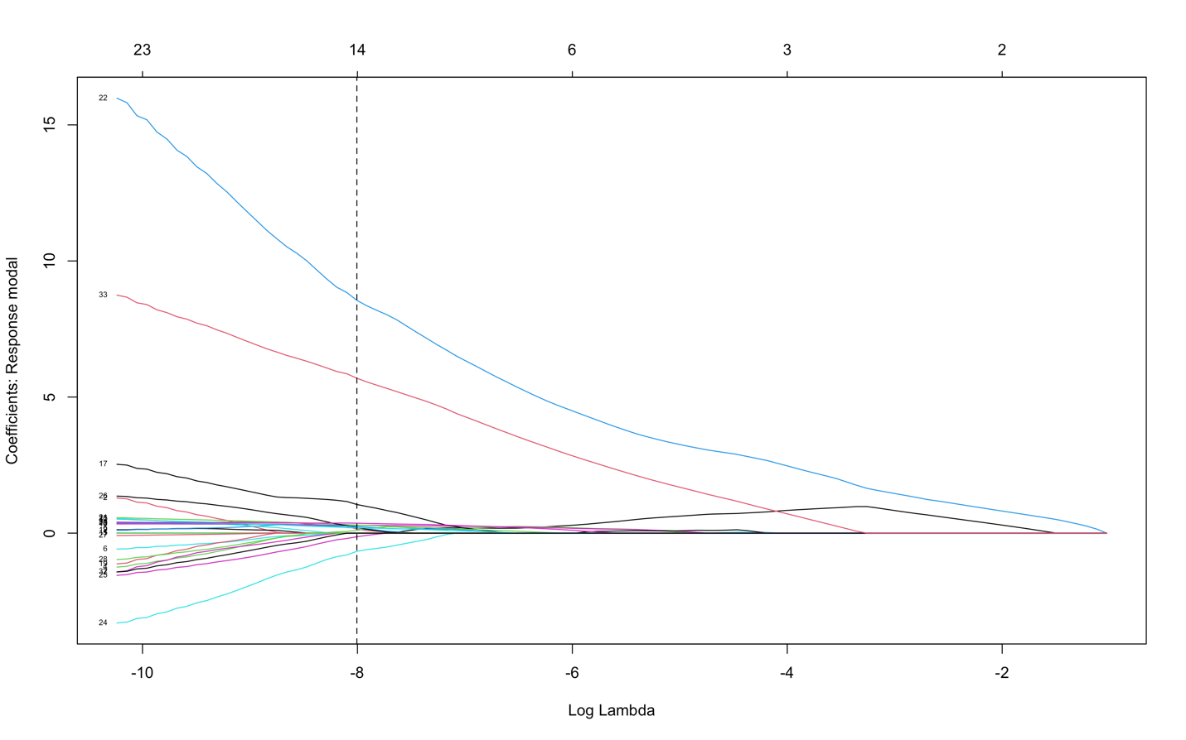
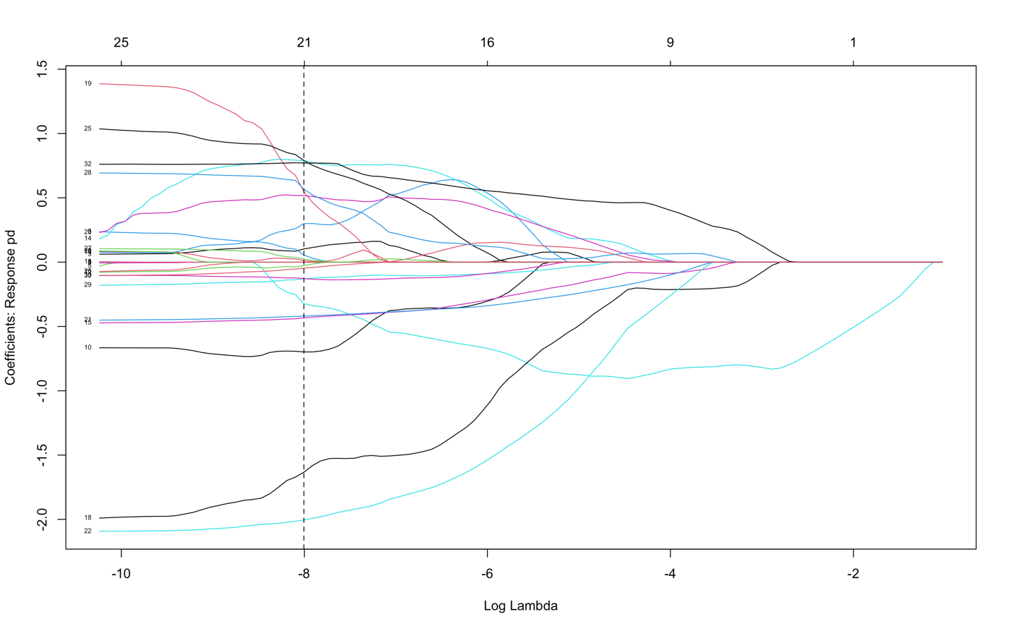
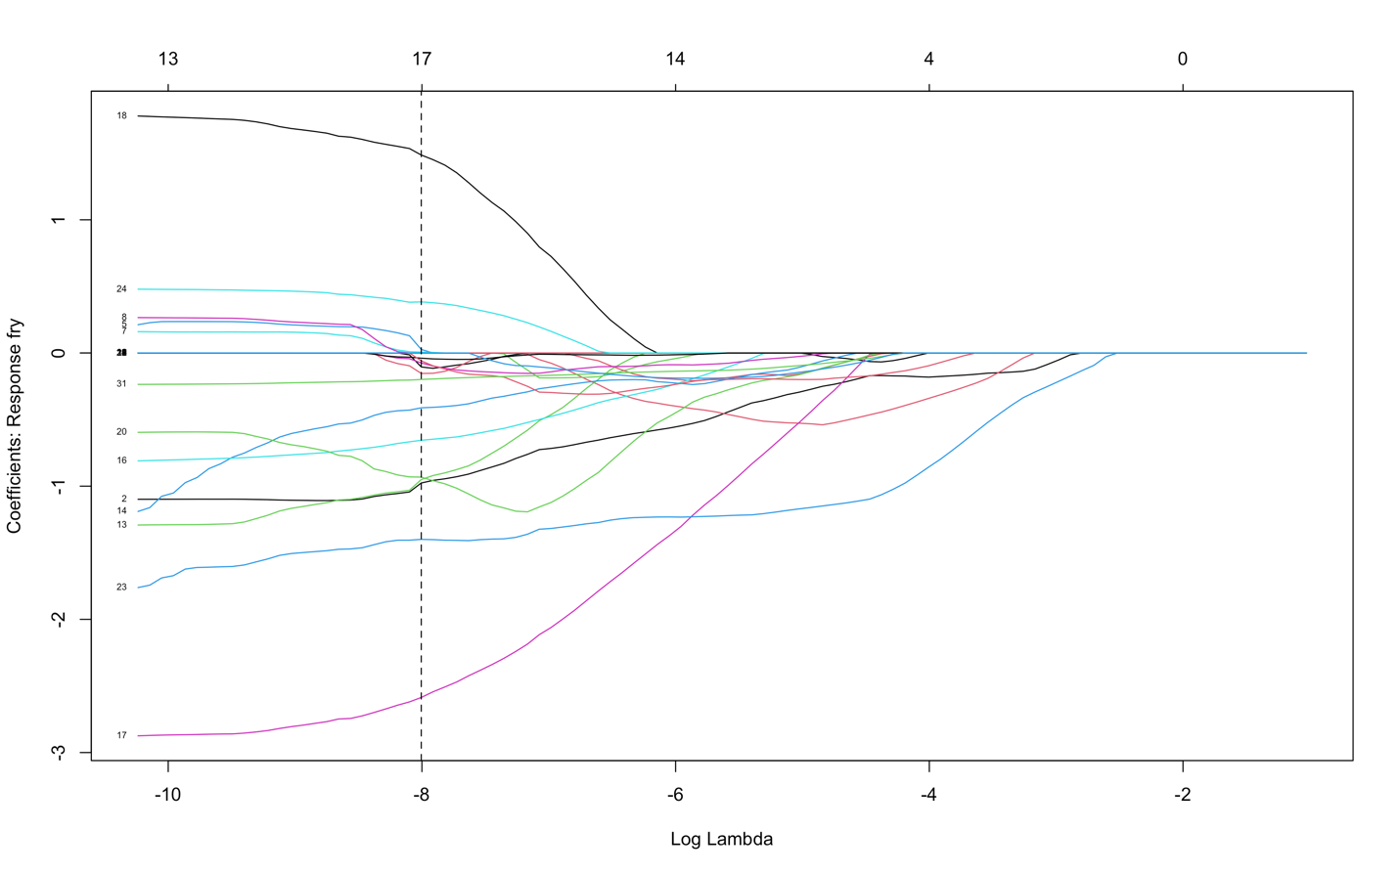



Lasso regularization
Notes:
Ridge vs. Lasso

Slide 48
K-means clustering
Vector quantization
Linear
Specify how many means (cluster centers), which are prototypes of the cluster
The distances in the feature space do no correspond to distances in the original space:
All vectors assigned to the same label are closer to the representative of that label than to the representative of any other label
Notes:
Rere vowel space

Slide 49
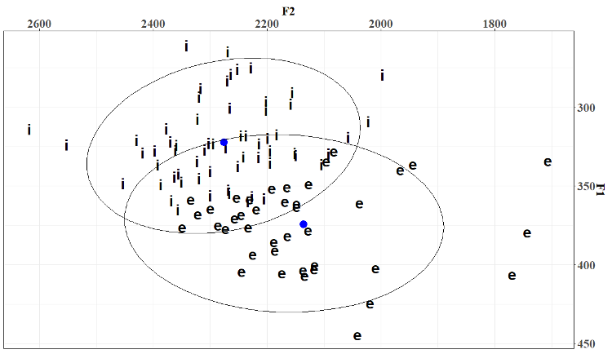
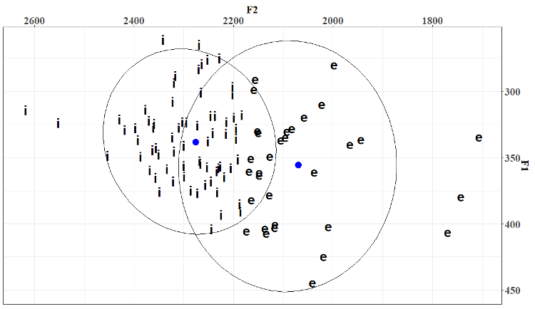
K-means clustering
Raw data
K-means clustering
Two instrumental suffix clusters conditioned by height of stem vowel in Rere
Huang (2022)
Notes:
Rere vowel space

Slide 50
Trends
Manifolds: can analyze non-linearities and capable of adapting to local structure of the data
Great for visualization
PCA is preferred due to its simplicity and intuitiveness
Decrease in the use of factor analysis (latent variables)
Notes:
Voice clusters

Slide 51
POLL
Which one would you like to learn more about how to implement?
PCA
T-SNE/UMAP
MDS
Other ML approaches (random forest; regularization, etc.)
Notes:
Why tritone

Slide 52

Thank you!
Questions?
Notes:
i'm happy to take any questions

Slide 53
I’ve got some data, what do I do next?
1.Data visualization, exploration
2.Hypothesis generation
3.Define a class of models (e.g. linear regressions, polynomial…)
4.Model selection: Which of the models within my class is appropriate?
Use cross-validation to choose
This ensures an appropriate balance of bias/variance, model complexity/overfitting, etc.
5.Model estimation: What are the best parameters of my model? What is the uncertainty of these parameters?
Use full data set to get the best parameter estimate
Use bootstrap to get the confidence intervals (error bars)

Slide 54
2-dimensional acoustic plot
Articulatory & acoustic
Clusters towards the bottom-right corner represent a typical creaky voice (more constricted);
Clusters towards the center-up represent a more modal voice (less constricted).
Notes:
Scatter plot of mean H1*–H2* and mean HNR of Tone 1 in different tonal sequences.

Slide 55
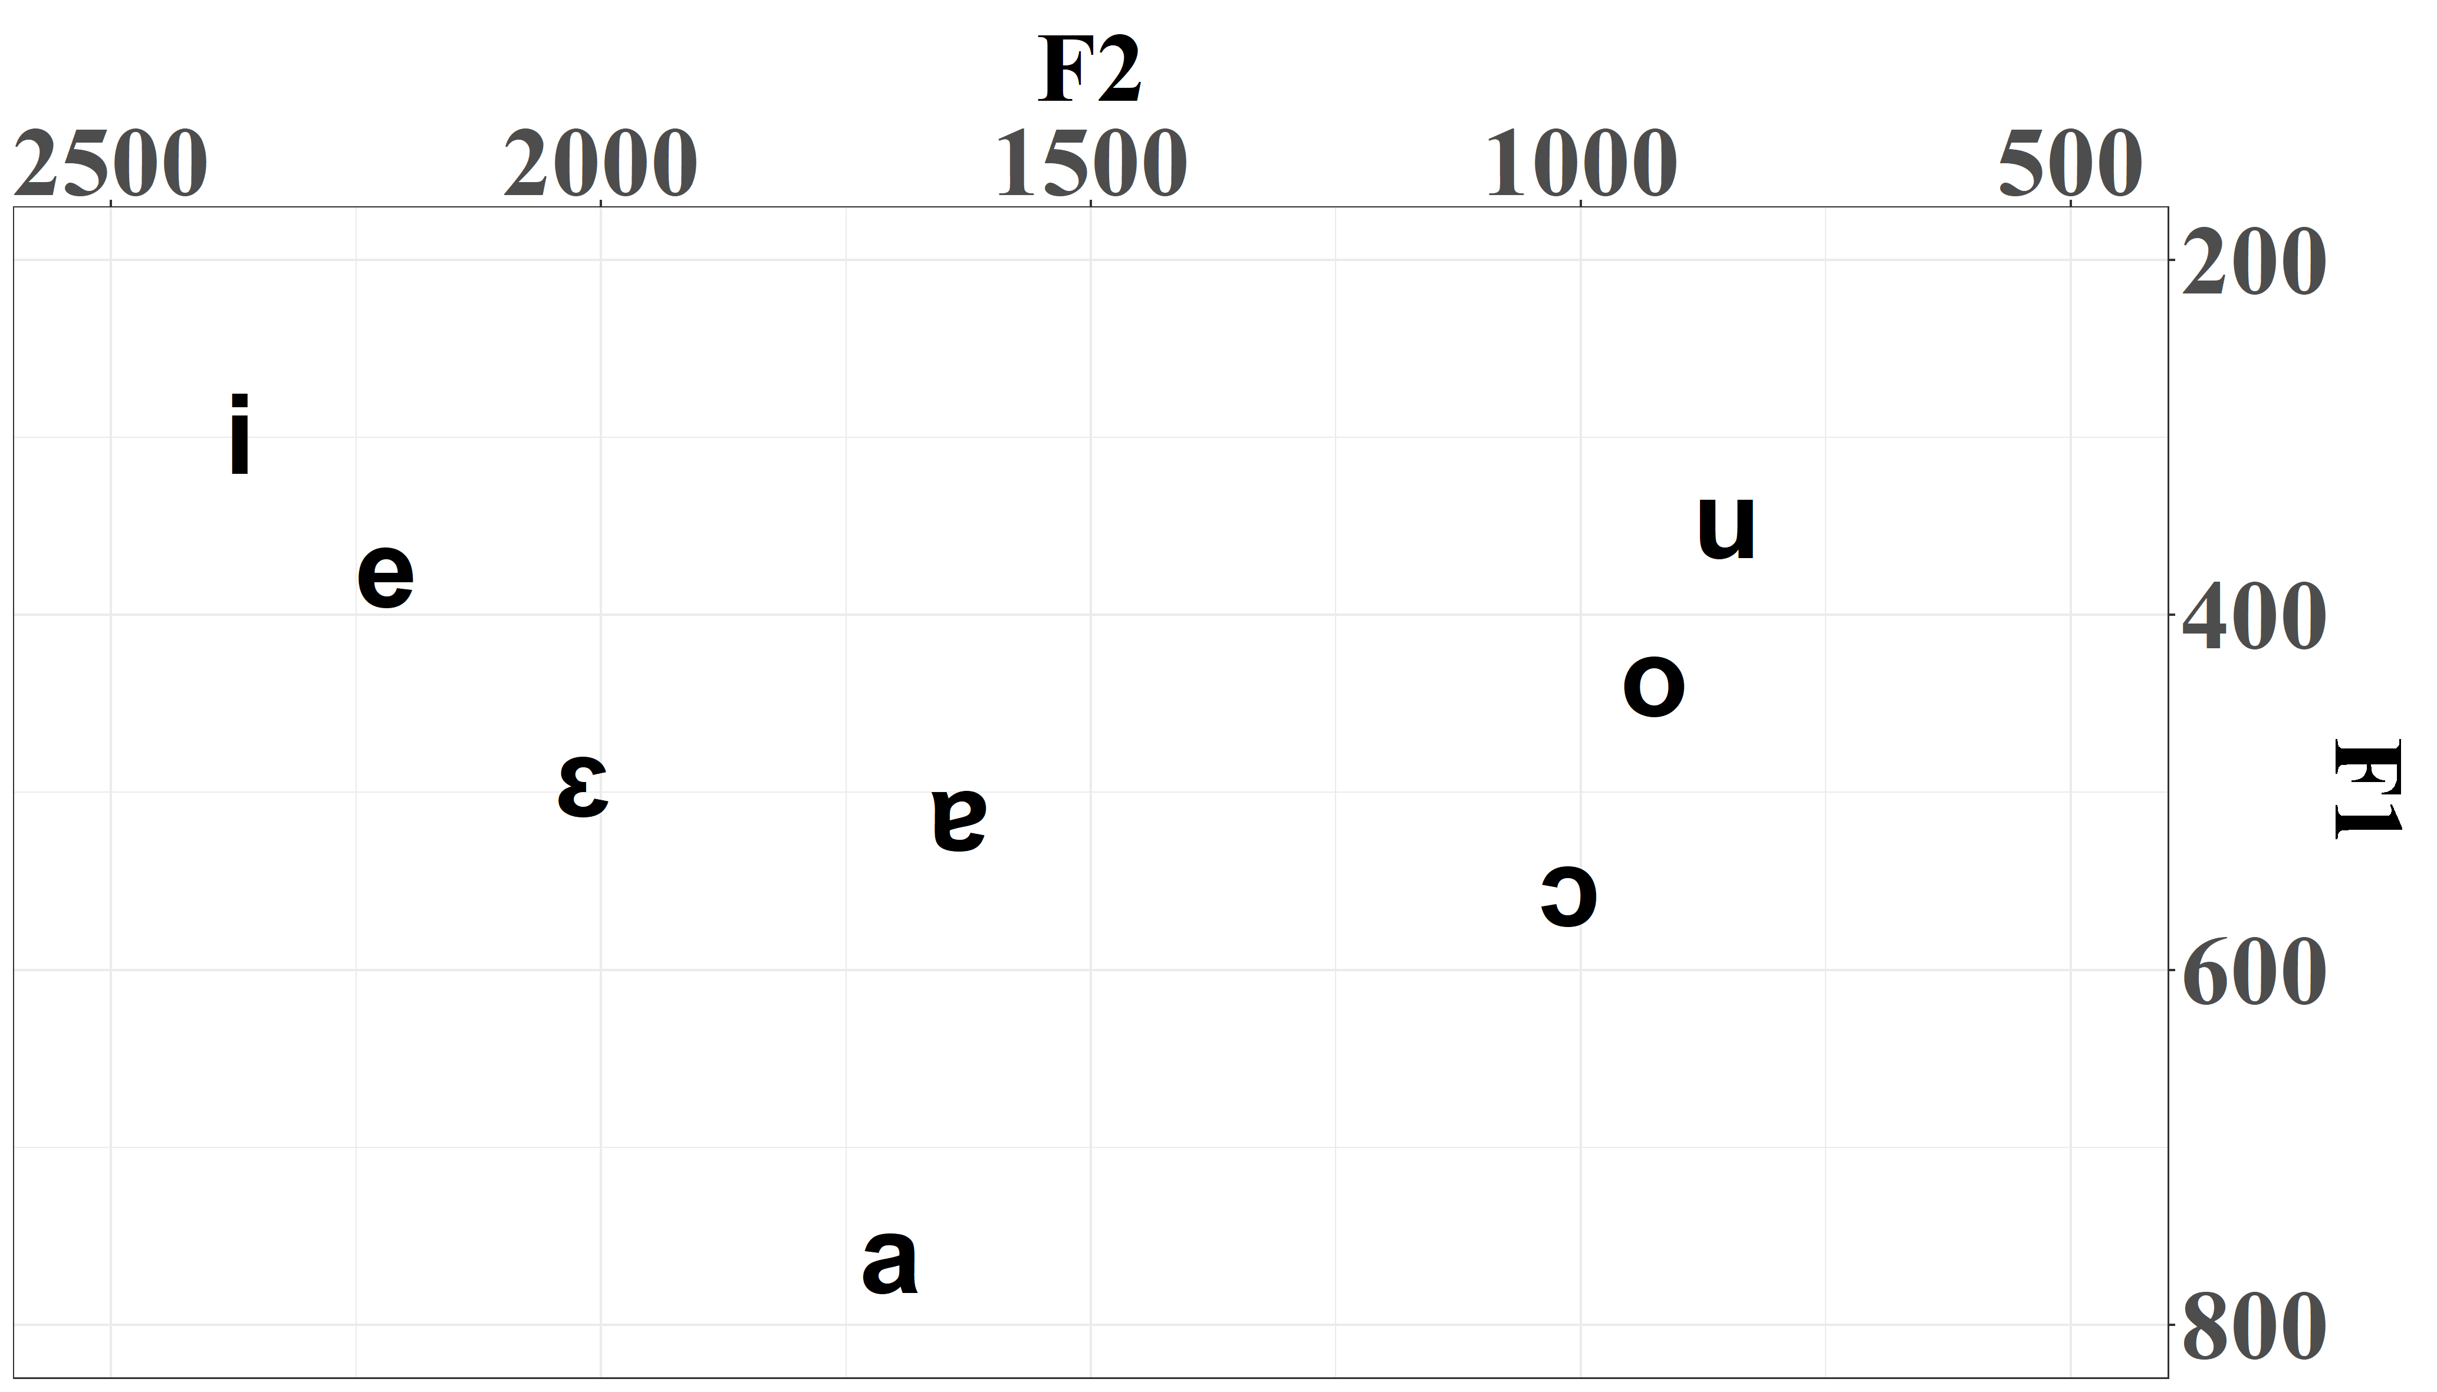
2-dimensional acoustic plot
Rere
Huang (2022)
Notes:
Scatter plot of mean H1*–H2* and mean HNR of Tone 1 in different tonal sequences.

Slide 56
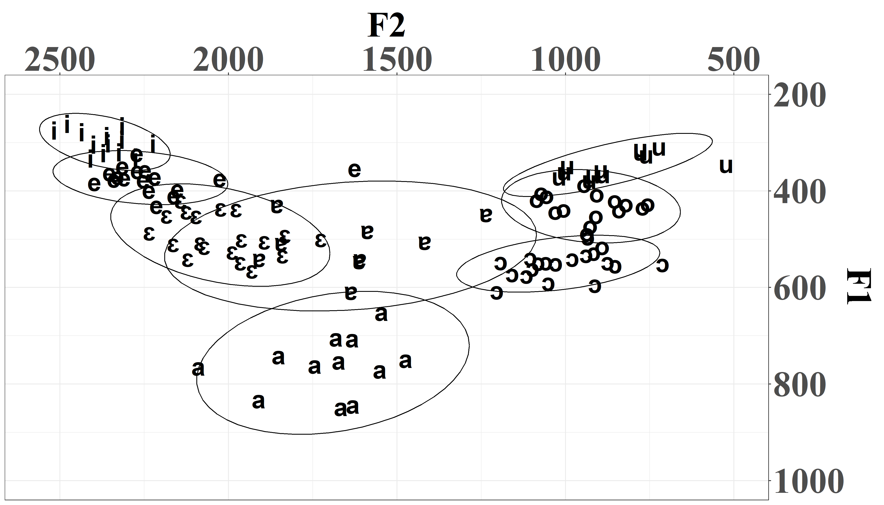
2-dimensional acoustic plot
Rere
Huang (2022)
Notes:
Scatter plot of mean H1*–H2* and mean HNR of Tone 1 in different tonal sequences.

Slide 57
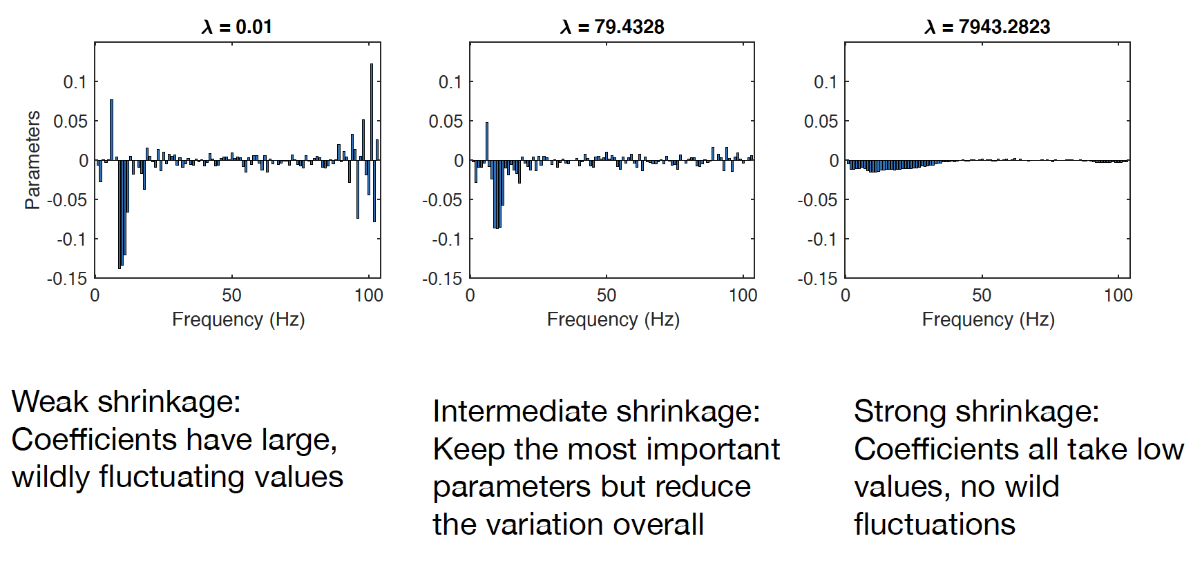
Regularization

Slide 58
Regularization
Figure showing 3 degrees
Weak shrinkage: Coefficients have large, wildly fluctuating values
Intermediate shrinkage: Keep the most important parameters but reduce the variation overall
Strong shrinkage: Coefficients all take low values, no wild fluctuations

Slide 59
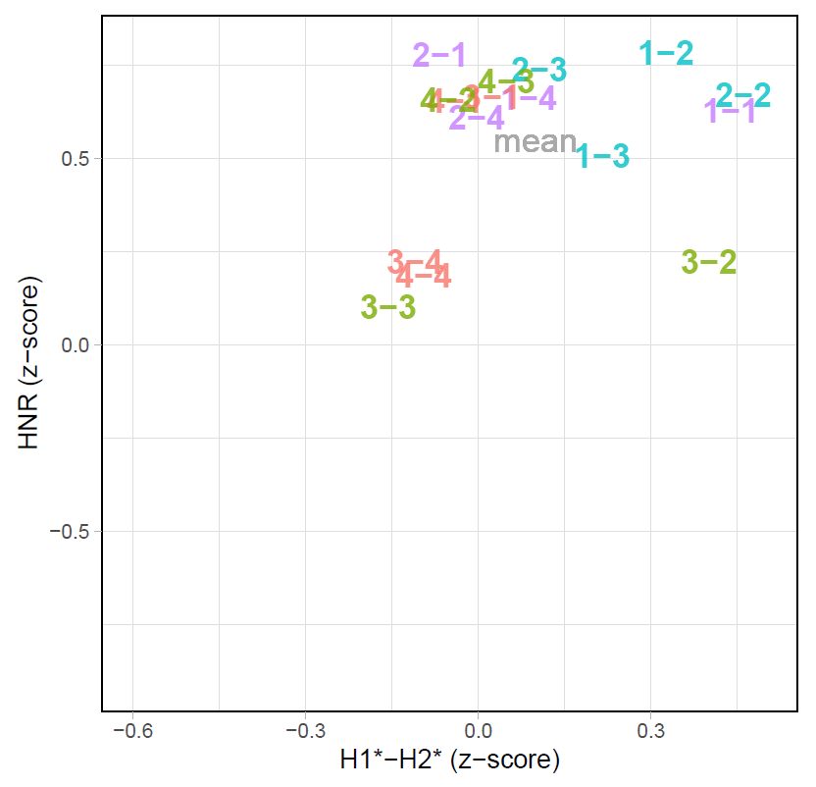
Tone 1 acoustics
Clusters towards the bottom-left corner represent a typical creaky voice (more constricted and noisier);
Clusters towards the up-right corner represent a more modal voice (less constricted and less noisy).
red: lowering; blue: raising; green: lowering-raising; purple: raising-lowering.
Notes:
Scatter plot of mean H1*–H2* and mean HNR of Tone 1 in different tonal sequences.

Slide 60
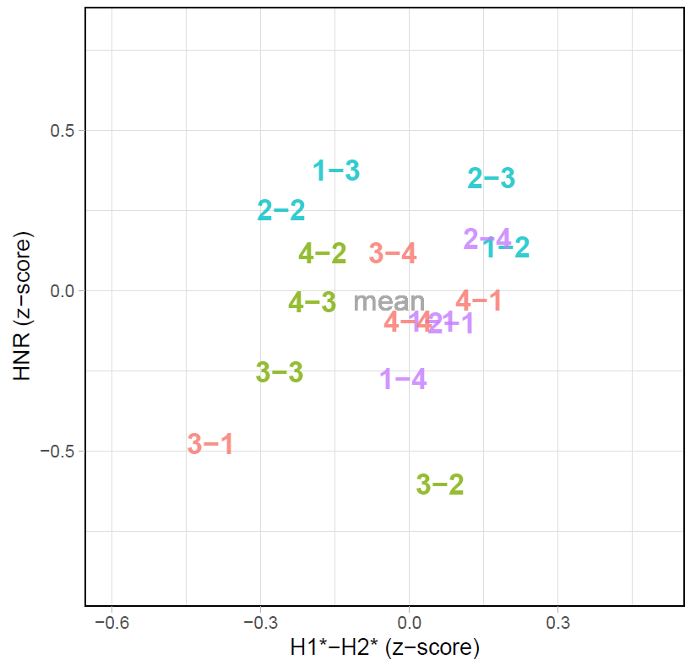
Tone 2 acoustics
Clusters towards the bottom-left corner represent a typical creaky voice (more constricted and noisier);
Clusters towards the up-right corner represent a more modal voice (less constricted and less noisy).
red: lowering; blue: raising; green: lowering-raising; purple: raising-lowering.

Slide 61
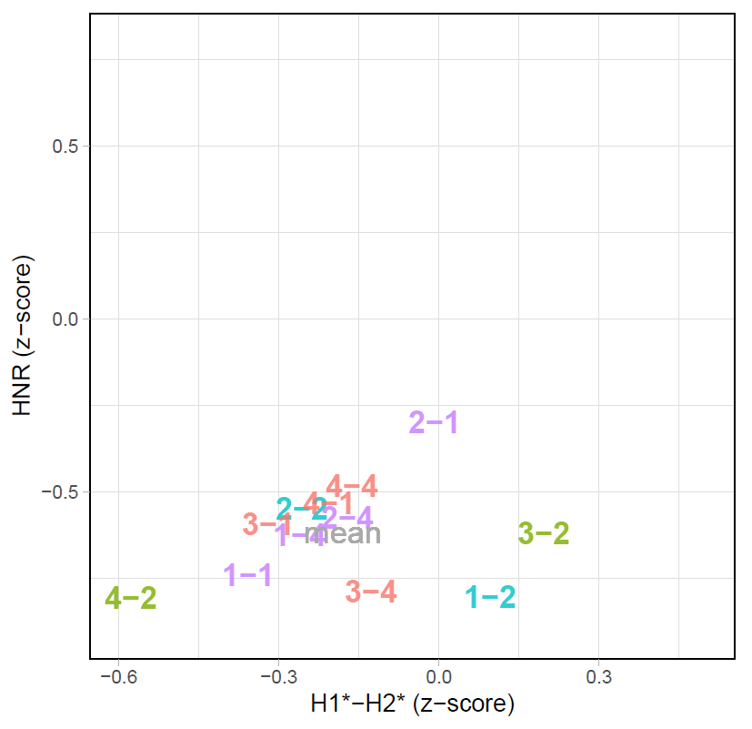
Tone 3 acoustics
Clusters towards the bottom-left corner represent a typical creaky voice (more constricted and noisier);
Clusters towards the up-right corner represent a more modal voice (less constricted and less noisy).
red: lowering; blue: raising; green: lowering-raising; purple: raising-lowering.

Slide 62
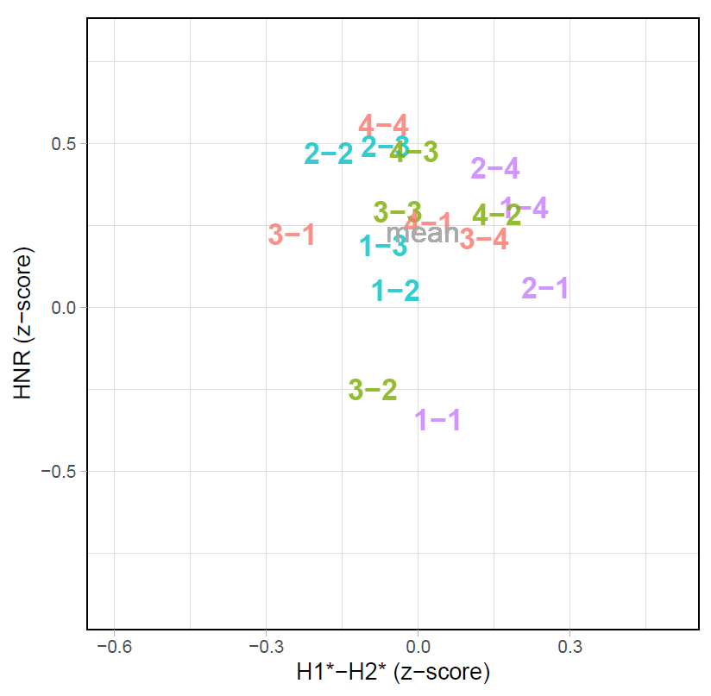
Tone 4 acoustics
Clusters towards the bottom-left corner represent a typical creaky voice (more constricted and noisier);
Clusters towards the up-right corner represent a more modal voice (less constricted and less noisy).
red: lowering; blue: raising; green: lowering-raising; purple: raising-lowering.

Slide 63
Discussion

Slide 64
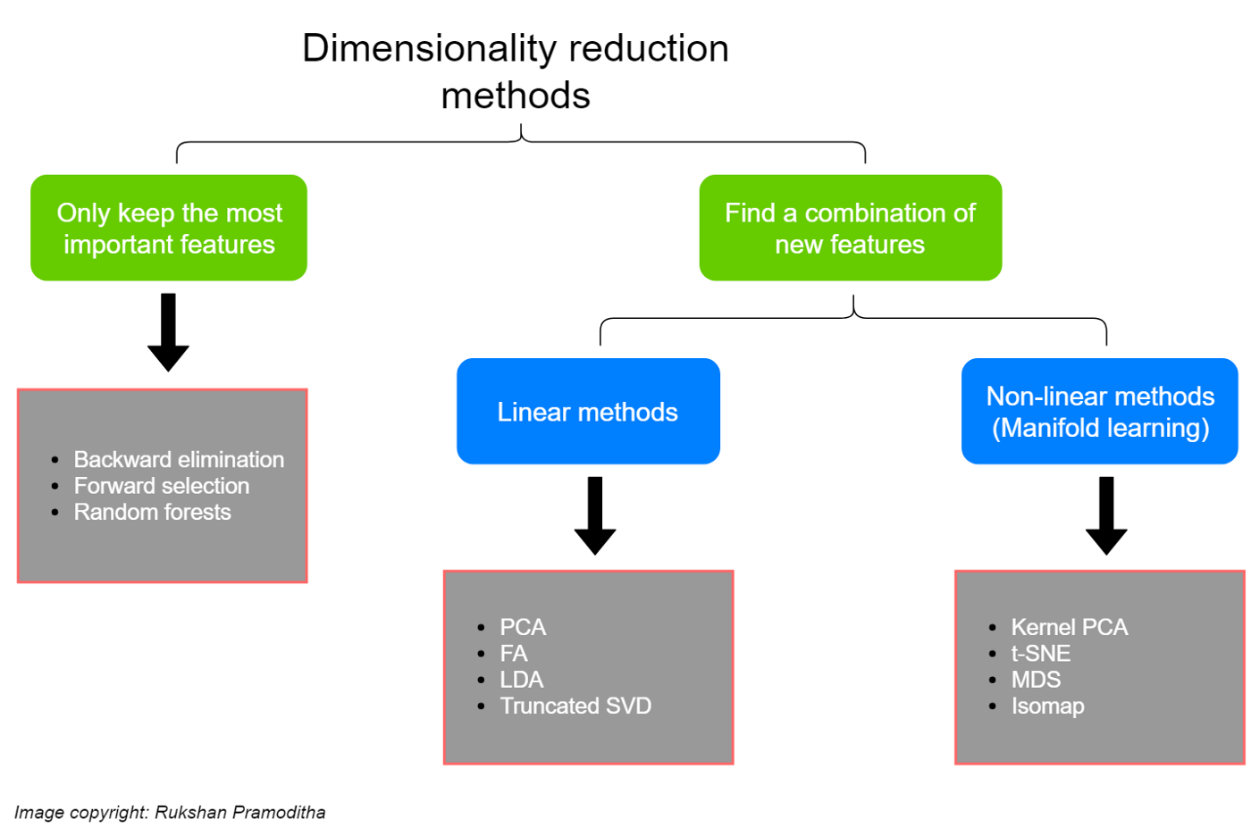

Slide 65
References

Slide 66
Supplementary figures

Slide 67
HNR

